Slide 1
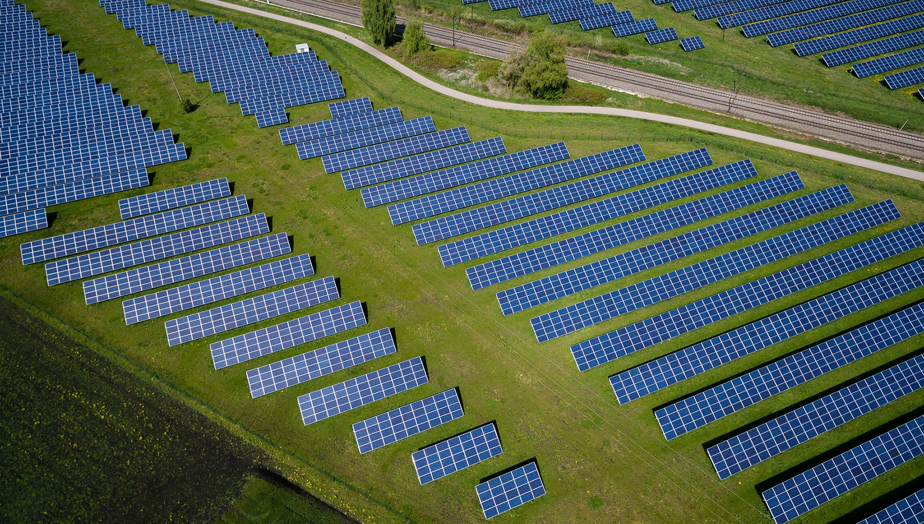
Asia EDGE Regional Competitive Procurement Dialogue
Sarah Lawson
November 18, 2019
Notes:
Thank you all for being here and welcome again to the Asia EDGE Regional Competitive Procurement Dialogue. My name is Sarah Lawson and I’m from USAID/Washington’s Global Energy team. My focus for the last four years has been on competitive procurement of utility scale renewable energy so this event is particularly exciting for me.

Slide 2
Presentation Outline
Dialogue Introduction
USAID Experience in Competitive Procurement
Building Blocks of Scaling Up Renewable Energy

Slide 3
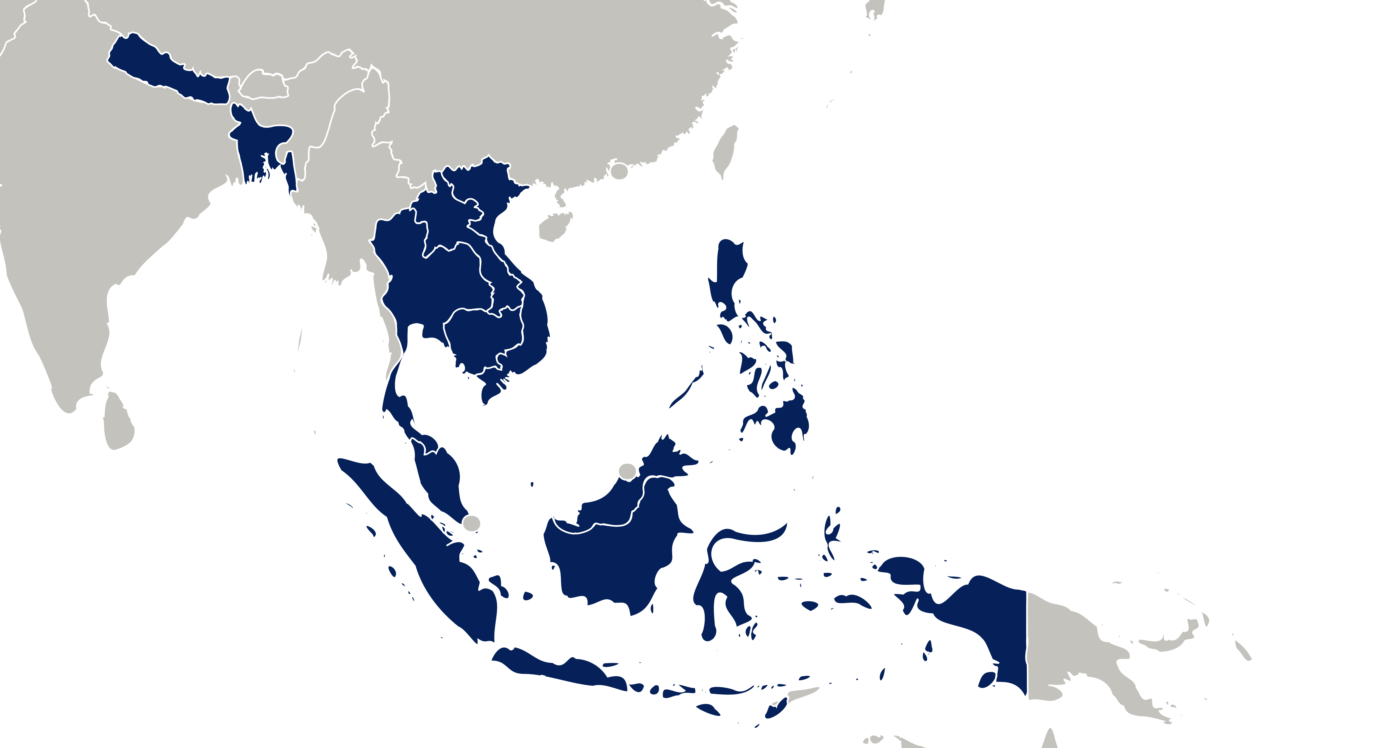
Participant Delegations
Map
Notes:
In the room we have representatives from 9 countries in South and Southeast Asia (Philippines, Lao PDR, Bangladesh, Nepal, Indonesia, Vietnam, Malaysia, Cambodia, and our hosts Thailand
The majority of representatives are from Ministries of energy, utilities, and regulators. (FINAL LIST) We also have expert speakers from Europe, the Middle East, North America, and Latin America as well as the region – in short almost every continent in the world represented.
The topic of our discussion for the next three days is competitive procurement of renewable energy. All over the world, we see that competitive procurement in the renewable energy space has helped capitalize on the cost declines in the wind and solar industry to achieve low prices for consumers in more than 50 countries around the globe.
As this competitive procurement spreads across Asia, we wanted to bring together all those stakeholders involved in procurement, planning, and execution.
We hope that this Dialogue will serve as useful platform for you to build relationships with one another and continue to exchange knowledge after this event is over.

Slide 4
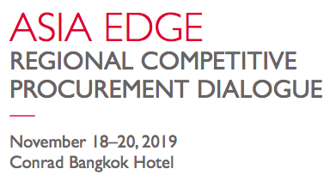
Dialogue Overall Goals
Acquire skills to design or modify a renewable energy competitive procurement in your country
Gain exposure to advanced procurement trends
Learn from and build relationships with energy stakeholders across the regions of South and Southeast Asia
Notes:
The overall goals of this workshop are to:
Firstly, acquire skills to design or modify an existing renewable energy competitive procurement, from key design elements like bid bonds, ceiling prices, guarantees, and environmental assessments to creating a fully bankable procurement package with key contracts such as the PPA, access to financing, both commercial and concessional if needed; and guarantees or government support if needed
Secondly, Gain exposure to advanced procurement trends, such as technology agnostic procurement, incorporating time of day or seasonal blocks, and utilizing locational or zonal frameworks for structuring procurement
Most importantly, we have convened leading stakeholders in the energy sector so we can learn from and build relationships with each other

Slide 5
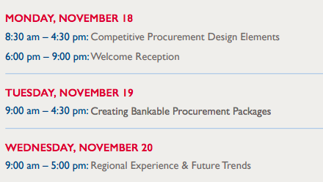
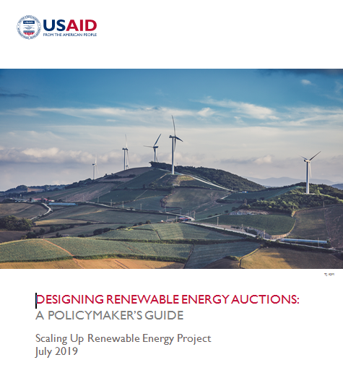
Introduction to Dialogue
Notes:
This conference was organized as a collaboration by the global Scaling up Renewable Energy Program and the Clean Power Asia program. In front of you, you should have booklets about the event, as well as printouts of your agenda.
You also have copies of our USAID Policymaker’s Guide to Designing Auctions (hold up) which provides a written format of the concepts that we will be discussing over the dialogue
You should also have a report form our PACE-D India project which focuses on more advanced trends in system integration of RE. We will be discussing takeaways from this report on Day 3.
We have a great team of facilitators here. Could all of them please raise your hand? If you have a question or need anything throughout the course of the dialogue, please let myself or one of them know.
At the end of today, we will have a welcome reception with soft drinks and snacks for everyone to meet each other. We hope you will all be able to attend.

Slide 6
Day 1 Learning Objectives: CP Design Elements
Understand global CP trends
Learn about how different market structures impact CP plans
Plan for grid integration challenges
Provide an overview of key design elements: definitions, policy goals, and setting prequalification criteria
Learn from India’s experiences in procurement over past 10 years
Notes:
We have an ambitious day planned. Our learning objectives:
Understand global CP trends
Learn about how different market structures impact CP plans
Plan for grid integration challenges
Provide an overview of key design elements: definitions, policy goals, and setting prequalification criteria
Learn from India’s experiences in procurement over past 10 years

Slide 7
Day 1 Agenda: CP Design Elements
IRENA, Global Trends in Competitive Procurement
Group Photo and coffee break
Interactive Session: Introductions & Energy Sector Mapping
HNEI: Grid integration challenges and solutions
Thymos Energia: Auctions & Market Structure
Indian auctions with USAID/India
Auction Key Design Elements I & II
Key Takeaways
Notes:
We will have IRENA who will be presenting takeaways from their most recent report
Afterwards, we will take a Group Photo and coffee break
Interactive Session: in which each country delegation will map their sectors and then introduce themselves
For the interactive sessions, please make sure you sit with your country delegation, if you are not already
Hawaii Natural Energy Institute will discuss Grid integration challenges and solutions
Thymos Energia: Auctions & Market Structure
We will have lunch
Indian auctions with USAID/India
Auction Key Design Elements I & II: process for designing an auction from beginning to end; we will include some interactive exercises as well
Key Takeaways: Country Delegations. We would like two countries to volunteer to briefly discuss their key takeaways in five minutes or less from the day.
May I just ask that you hold your questions until the end of the presentation

Slide 8
Day 2 and Day 3 of Dialogue
Notes:
Tomorrow: Building on Day 1, Day 2 will continue with building a bankable procurement package with best practice contractual documents, financing, and guarantees/government support
Day 3: we will focus on experience in the region, with presentations from many of you in the room, as well as a look at future trends like storage and advanced auction design elements
Throughout the Dialogue, we will be leading each delegation to design or modify your country’s competitive procurement/auction design, culminating with a session on Wednesday to either finish your design or conference with some of our experts to discuss questions or RE topics of
OR a sample country (LOOK AT EXERCISES)

Slide 9
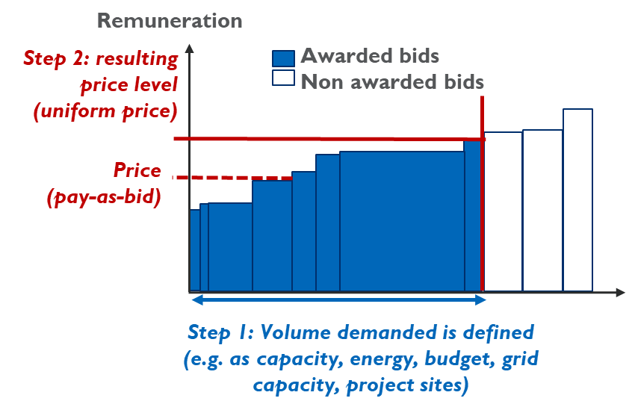
Definition of Competitive Procurement
Advantages | Volume control. Competitive pricing. Faster project execution after award than in negotiated procurement. Easier to scale up for multiple projects and rounds.
Disadvantages | Requires competition. Bidders face risk of not being awarded (sunk costs). Risk of underbidding and project failure.
Notes:
I believe we have a range of experience in the room here today. Some of you are likely new to this concept. Also, everyone refers to this differently depending on where they’re from.
So for the purpose of our event, when we are referring to competitive procurement, we are referring to a process
Competitive procurement is a transparent process for procuring new renewable energy which requires different bidders to compete on price
Usually, the least cost option, or lowest price, wins the contact
We will also be referring to auctions, which is the term used most often in the energy industry and globally. For the purposes of this Dialogue, those terms will have the same meaning
Getting into much more detail later in the day

Slide 10
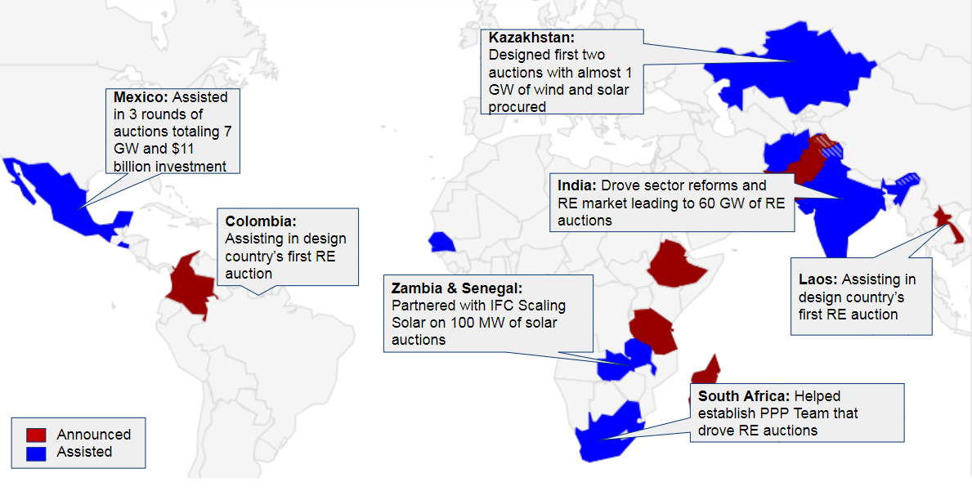
USAID Experience in Competitive Procurement
Notes:
Before we move forward, I wanted to highlight some of USAID’s experiences in competitive procurement:
Supporting Mexico’s 3 auction rounds of 8 GW of wind and solar at low prices
Recently supporting Colombia with their first RE competitive procurement
Support to Kazakhstan’s 3 RE auctions
Partnering with the Government of India
Working with the Government of Lao on their first auction
I wanted to particularly highlight Colombia here, which was just awarded a few weeks ago. The auction awarded contracts for nine projects that will provide 1,374 megawatts (MW) of new wind and solar power generation, at a historic-low average price for the country of approximately 2.8 cents per kWh
Support ranged from building institutional capacity through planning the auctions, to study tours to learn directly from countries that have done competitive procurements to assisting in electronic platform for competing, to workshops like this one and one on one assistance to Ministries of energy, utilities, regulators, and system operators

Slide 11
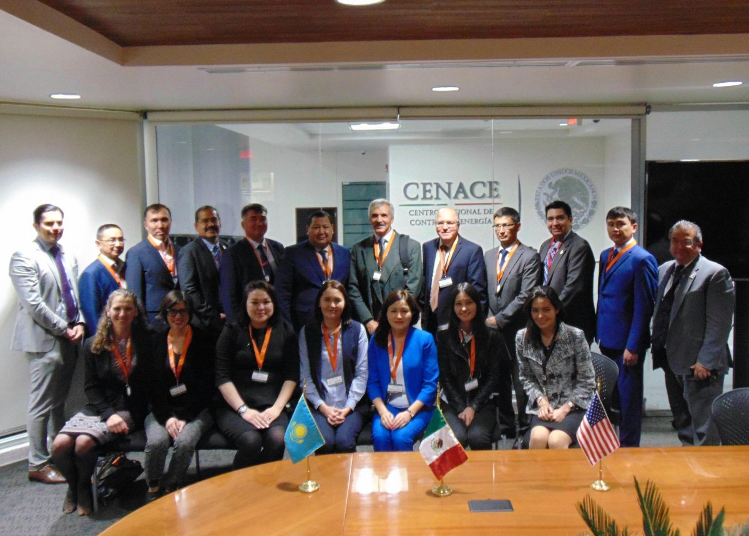
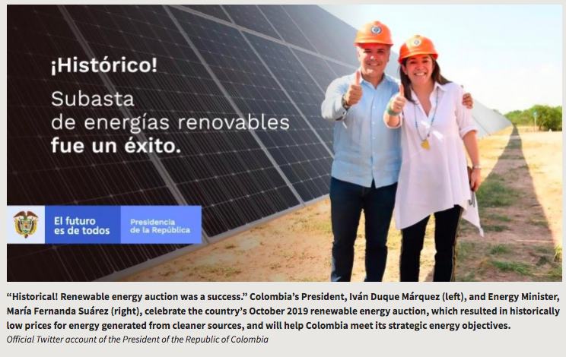
USAID Experience in Competitive Procurement
A Kazakh energy delegation visits Mexico’s system operator and auctioneer, CENACE, in 2017
Colombia’s President and Energy Minister announce the successful auction results, Oct 2019
Notes:
A Kazakh energy delegation visits Mexico’s system operator and auctioneer, CENACE, in 2017
Colombia’s President and Energy Minister announce successful results on Twitter, 2019
Talk to any of us if you’d like us to assist in helping your country more closely on this topic

Slide 12
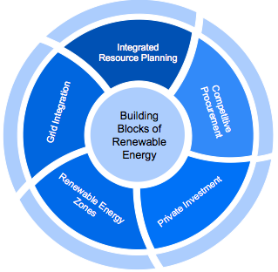
Building Blocks of
Scaling up Renewable Energy
Integrated Resource Planning
Grid Integration
Competitive Procurement
Renewable Energy Zones
Private Investment/Financing
Notes:
At USAID, we call these the building blocks for scaling up renewable energy
These building blocks were strongly associated with both large and rapid additions of renewable energy, particularly wind and solar PV in countries in Latin America, Europe, and Asia. In addition, there is a clear logical connection between the building blocks and RE investment activity.

Slide 13
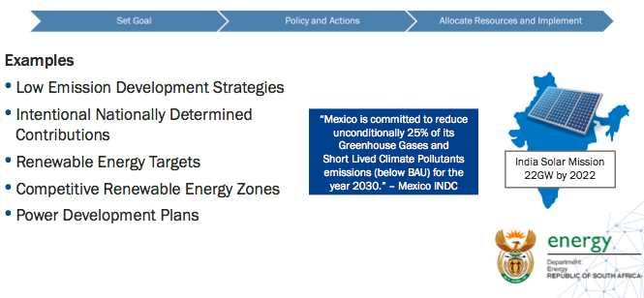
Strategic Energy Planning
Notes:
Good government planning such as strategies, roadmaps, and setting clear targets sets the stage for increase RE penetration
Mex, India, and South Africa have all set clear RE targets

Slide 14
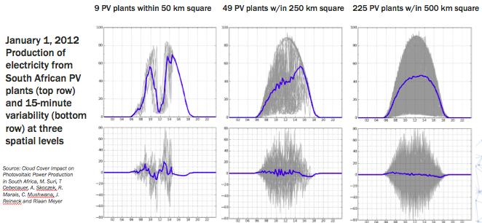
Grid Integration
Notes:
Grid integration is the practice of mitigating the inherent variability and intermittency of RE (although also important to think of thermal as sometimes intermittent given that lack of availability of fuel)
Combining PV plants reduces variability
Above, South African PV plants aggregated across larger numbers of plants smooths generation and reduces variability
(balancing area?)
USAID has conducted grid integration studies in India and Philippines
This study was led and championed by DOE, which institutionalized the study via Department Circular No. DC 2015-11-0017, which was signed in November of 2015.
The DC established the stakeholder framework for the grid integration study. The study is co-chaired by DOE and USAID and supported by a diverse Technical Advisory Committee. The actual analysis is conducted by a Modeling Working Group consisting of representatives from DOE, NGCP, GMC, and PEMC, as well as the U.S.’s National Renewable Energy Laboratory.
One of the major findings of the Greening the Grid study was that no technical barriers to achieving 30% or 50% by 2030 were found by the modeling team, even when the majority of this RE is from variable resources such as solar and wind.
HNEI will be discussing this in detail later today

Slide 15
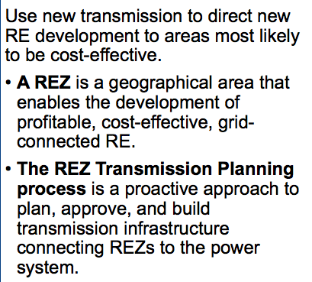
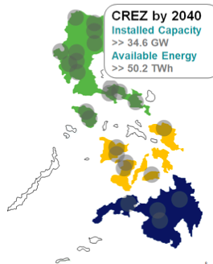
Renewable Energy Zones
Philippines CREZ Process
Notes:
Use new transmission to direct new RE development to areas most likely to be cost-effective.
What is a REZ?
A REZ is a geographical area that enables the development of profitable, cost-effective, grid-connected RE.
REZs have:
High-quality, concentrated RE resources (focus is on wind and solar PV)
Suitable topography and land-use designations
Demonstrated interest from developers
The REZ process:
Helps to increase the share of solar, wind and other RE resources in the power system while maintaining reliability and economics.
Focuses on large-scale wind and solar resources that can be developed in sufficient quantities to warrant transmission system expansion and upgrades.
Philippines is currently working with USAID on this process of identifying REZ sites
In September 2018, the Philippines DOE issued a Department Circular on the "Establishment and Development of CREZ in the Country"
Formalizing a CREZ process to connect the country's transmission development to areas with excellent RE resources.
Establishes an advisory committee and working groups

Slide 16
THANK YOU!
Comments or questions
Please contact Sarah Lawson at slawson@usaid.gov

Slide 17
Day 1 Recap & Intro to Dialogue Day 2
Notes:
Thank you, I can’t wait to meet everyone and learn from you this week
Without further ado, I’d like to introduce Diala Hawila from IRENA

Slide 18
Day 1 Recap & Day 2 of Dialogue

Slide 19
Day 2 Learning Objectives: Bankable Procurement Packages
Learn how to develop a bankable competitive procurement package with tools appropriate to country context
Map legal and financial risks in key contractual documents
Integrate social and economic impact into CP planning
Learn from unique case studies in Brazil and Hawaii
Notes:
Learn how to develop a bankable competitive procurement package with tools appropriate to country context
Map legal and financial risks in key contractual documents
Integrate social and economic impact into CP planning
Learn from unique case studies in Brazil and Hawaii

Slide 20
Day 2 Agenda: Creating Bankable Procurement Packages
Developing a Procurement Package of Tools
Thymos: Brazilian Auctions Perspective
Panel with DFDL: Creating Conditions for Project Success
HNEI: Hawaii Procurement Case Study
Interactive Session: Risk Mapping Exercise
IRENA: Ensuring a Just and Inclusive Transition
Key Takeaways
Notes:
Developing a Procurement Package of Tools
Thymos: Brazilian Auctions Perspective
Panel: Creating Conditions for Project Success
HNEI: Hawaii Procurement Case Study
Interactive Session: Risk Mapping Exercise
IRENA: Ensuring a Just and Inclusive Transition
Key Takeaways

Slide 21
Day 2 Recap & Day 3 of Dialogue

Slide 22
Day 3 Learning Objectives: Regional Experience & Future Trends
Learn from regional auctions experience
Understand recent utility scale storage economics in auctions & future trends in auction design
Learn from case studies in Mexico and Japan
Design/modify final auction design in country delegations
Notes:
Learn from regional auctions experience
Understand recent utility scale storage economics in auctions & future trends in auction design
Learn from case studies in Mexico and Japan
Design/modify final auction design in country delegations

Slide 23
Day 3 Agenda: Regional Experience & Future Trends
Panel Discussion: Regional Auction Experience
IRENA: Lessons Learned from Mexico and Japan
Advanced Auction Design Elements
Speak with an Auctions Expert
CEADIR: Utility Scale Storage Economics
Interactive Session: Designing an Auction
Key Takeaways
Notes:
Panel Discussion: Regional Auction Experience
IRENA: Lessons Learned from Mexico and Japan
Advanced Auction Design Elements
Speak with an Auctions Expert
CEADIR: Utility Scale Storage Economics
Interactive Session: Designing an Auction
Key Takeaways

