Slide 1
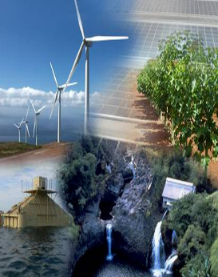

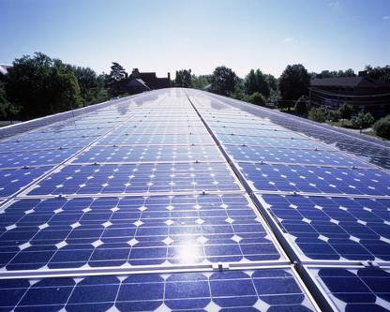


RE Grid Integration Challenges & Solutions
The Hawaii Experience
Grid System Technologies Advanced Research Team
Leon R. Roose, Esq.
Principal & Chief Technologist, GridSTART
Marc M. Matsuura, PE
Sr. Smart Grid Program Manager, GridSTART
Hawaii Natural Energy Institute
School of Ocean & Earth Science & Technology
University of Hawaii at Manoa
1680 East-West Road, POST 109
Honolulu, Hawaii 96822
International Workshop sponsored by the U.S. Agency for International Development (USAID)
Asia EDGE Competitive Procurement Dialogue
November 18-20, 2019
Conrad Bangkok
Bangkok, Thailand

Slide 2

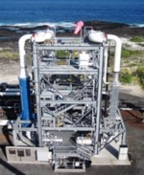
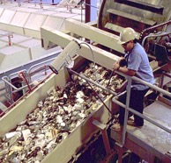
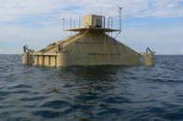
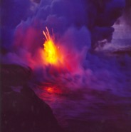
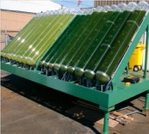
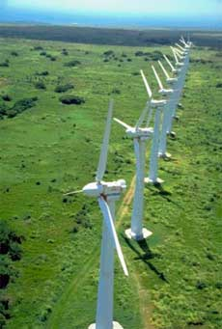
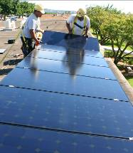
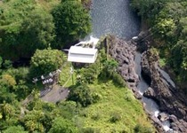

Opportunity for Sustainability in Hawaii is Abundant
Source: National Renewable Energy Laboratory, Hawaii Clean Energy Initiative Scenario Analysis, 2012; and DBEDT
2

Slide 3
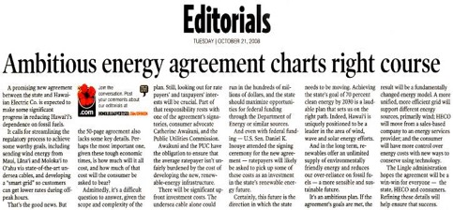

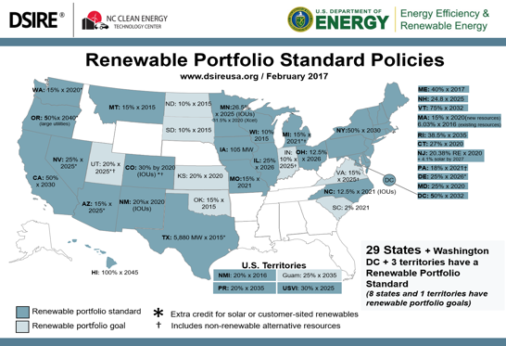
Hawaii’s Progressive Clean Energy Policy Leadership
Hawaii Clean Energy Initiative (HCEI)
The State of Hawaii, US DOE, and local utility launched HCEI in January 2008 to transform Hawaii to a 70% clean energy economy by 2030:
Increasing Hawaii’s economic and energy security
Fostering and demonstrating Hawaii’s innovation
Developing Hawaii’s workforce of the future
Becoming a clean energy model for the U.S. and the world
Strong Hawaii Policies
Highest RPS Target
in the United States
100% by 2045
(2015 - 15%; 2020 - 30%, 2030 – 40%, 2040 – 70%)
Key implementing policies:
Tax incentives
Net metering
Feed in tariffs
Decoupling

Slide 4
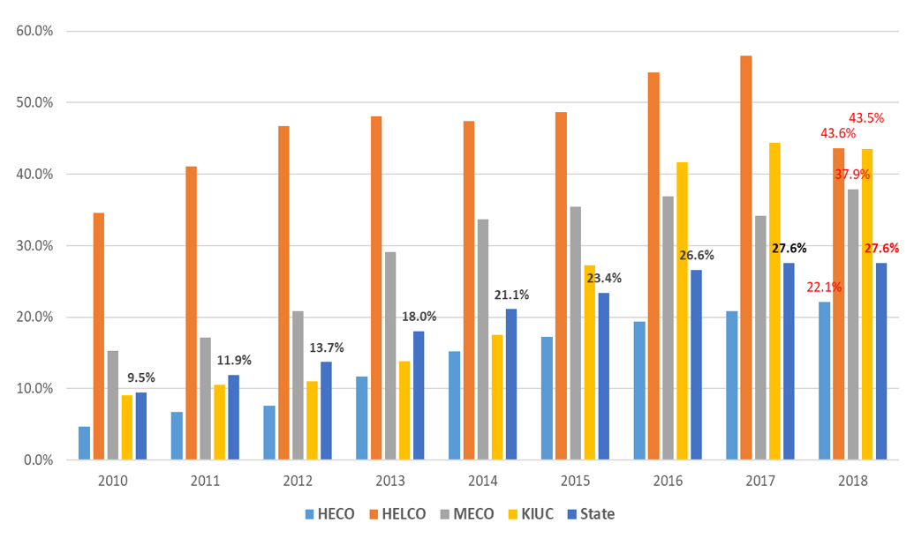

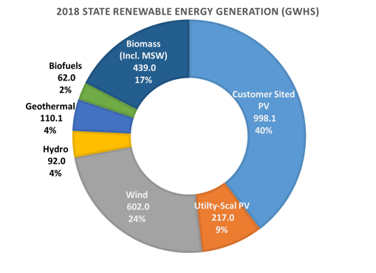
Progress Exceeds Hawaii RPS Goals
Hawaii RPS Goals
2015 - 15%
2020 - 30%
2030 - 40%
2040 - 70%
2045 - 100%
Loss of
Geothermal May 2018
Production
Source: Hawaiian Electric and Kaua’i Island Utiltiy Cooperative 2018 RPS Reports

Slide 5
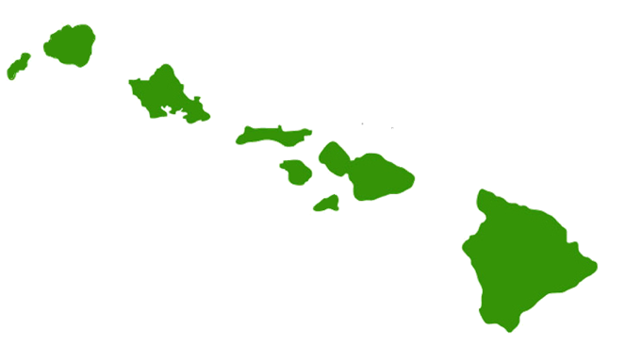
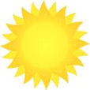
Hawaii Electric Systems –
4 Electric Utilities; 6 Separate Grids; % Renewable Energy
Kauaʻi Island Utility Cooperative
System Peak: 78 MW
86 MW PV* / 7 MW Biomass / 9 MW Hydro
Installed PV: 110% of System Peak
Maui Electric
Maui System Peak: 202 MW
113 MW PV / 72 MW Wind
Installed PV & Wind:
91% of Sys. Peak
Lana’i System Peak: 5.1 MW
3.8 MW PV (75% of Sys. Peak)
Moloka’i System Peak: 5.6 MW
2.2 MW PV (41% of Sys. Peak)
*14 MW Solar under construction
Kaua’i
44%
Oʻahu
80% of state population
21%
Molokaʻi
Hawaiian Electric
System Peak: 1,206 MW
620 MW PV* / 99 MW Wind /
69 MW WTE / 168 MW Biofuel
Installed PV & Wind:
60% of System Peak
Maui
38%
Hawaii Electric Light
System Peak: 192 MW
101 MW PV / 31 MW Wind /
38 MW Geothermal* / 17 MW Hydro
Installed PV & Wind:
69% of System Peak
Lanaʻi
Hawaiʻi
44%
27.6 %
Renewable Energy Statewide
2018
*Geothermal Plant not in operation
Notes:
As of 9/2019
HELCO
101 MW DG
Wind
10.5 MW - HRD
20.5 MW - Pakini Nui
31 MW
RR Hydro
12.1 MW – Wailuku River
1.1 MW – Waiau
3.4 MW – Puueo
16.6 MW
Geothermal
38 MW – PGV
Biomass
21.5 - Honua Ola (Under Construction)
MECO (See Maui Island slide notes)
Solar
2.2 MW DG – Molokai
1.6 MW DG – Lanai
1.2 MW Central – Lanai
3.8 MW
111.54 MW DG – Maui
2.87 MW – Kula Solar
2.87 MW – SMRR
117.28 MW
Wind
30 MW – KWP
21 MW – Auwhi
21 MW – KWP 2
72 MW
HECO
Wind
30 MW - Kahuku Wind
69 MW - Kawailoa Wind
99 MW
Solar
448 MW - DG PV
1 MW - Kalaeloa Renewable Energy Park
5 MW - Kalaeloa Solar 2
5 MW - Kalaeloa Renewable Energy Park
5 MW - Waihonu North
1.5 MW - Waihonu South
27.6 MW - Waianae Solar
5 MW - Aloha Solar I
14.7 MW - Lanikuhana Solar
45.9 MW - Waipio PV (Waiwa PV)
49 MW – Kawailoa Solar
11 MW - Waipio Solar Facility
1.23 MW – Pearl City Peninsula PV
620 MW
110 MW – NRG (Under Construction)
20 MW – West Loch (Under Construction)
WTE
H-Power 68.5 MW
Biofules
110 MW - CIP
50 MW - Schofield
8 MW – Airport
168 MW
KIUC
Biomass
6.7 – Green Energy Biomass
Hydro
1.3 MW – Gay & Robinson
0.125 MW – Green Energy Hydro
1 MW – Kauai Coffee Kalaheo
4 MW – Kauai Coffee McBryde
0.800 MW – Waiahi (lower)
0.500 MW – Waiahi (upper)
0.500 MW – Waiawa
1.25 MW – Waimea
9.475 MW
25 MW – West Kauai Energy (Proposed)
Solar
20 MW – AES Lawai Solar (Under Construction)
21 MW - DGPV
1 MW - Kapaa Solar
12 MW –Anahola (REC solar)
12 MW – Koloa (SolarCity)
0.300 MW – Kaneshiro
6 MW – Port Allen
13 MW – SolarCity/Tesla
0.25 MW – pioneer
0.25 MW – Waimea Research
0.5 MW - Wilcox
86.3 MW
14 MW – AES Kekaha (In Construction)
Hawaii Renewable Energy Projects
Directory
https://energy.ehawaii.gov/epd/public/energy-projects-map.html

Slide 6
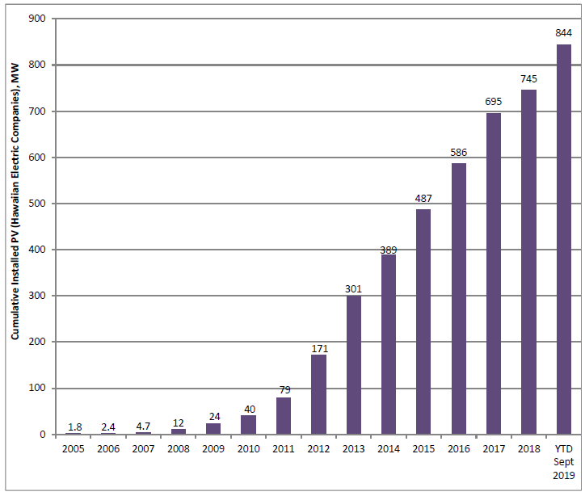
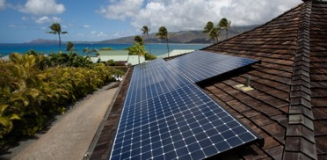
Installed PV Capacity - HECO Companies
(2005 to 2018)
½ Peak Load

Slide 7
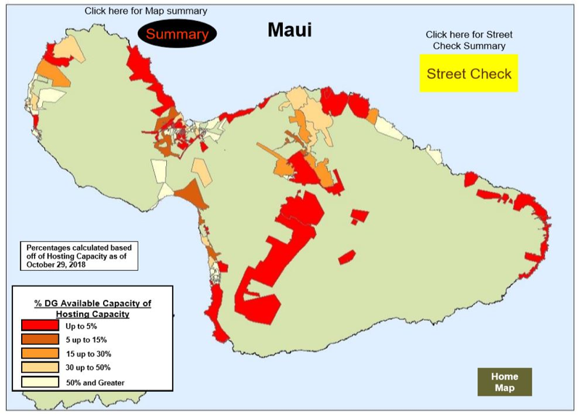
Distributed PV Circuit Penetrations in Hawaii
Maui Electric
Maui System Peak: 202 MW
113 MW PV / 72 MW Wind
Installed PV & Wind:
91% of Sys. Peak
DG PV capacity = 56% peak load
13% Energy
Wind capacity = 36% peak load
21% Energy
Reverse power flow exists on the vast majority of distribution circuits today
PV penetration on some circuits exceed 300% Daytime Minimum Load (DML)

Slide 8
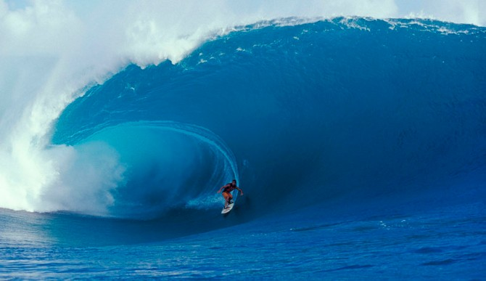
Get ahead of the curve!
Rooftop solar is a customer choice
Grid Codes are key - build in inverter performance requirements today to enable high PV penetration tomorrow
Consider proactive methods such as circuit Hosting Capacity analysis rather than rule-of-thumb screens
Consider DER as a grid asset – how do you extract the greatest value
Ride the reverse power flow wave

Slide 9
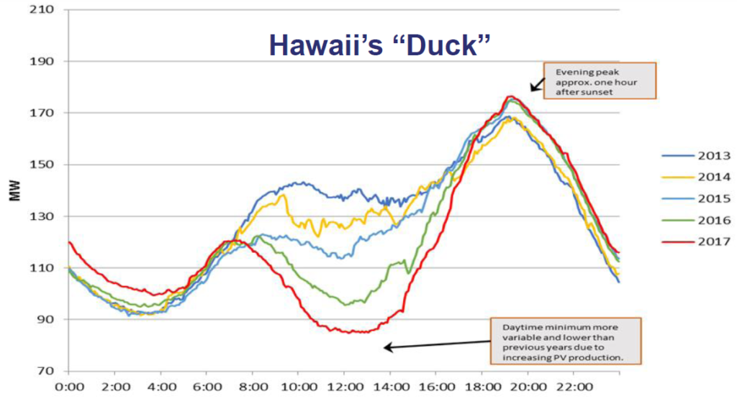
Net Load Curve

Slide 10
Hawaii Renewable Energy Grid Integration Studies
Develop rigorous analytic models of electricity grids
Analyze impact of new energy systems including renewable generation, end-use energy efficiency, and transportation systems
Analyze solutions to address system integration issues
  Generator modifications
  RE advanced controls
  RE forecasting
  Demand response
  Storage
  Smart grids
Tools are used together to assess the challenges and provide information needed for advanced energy solutions

Slide 11
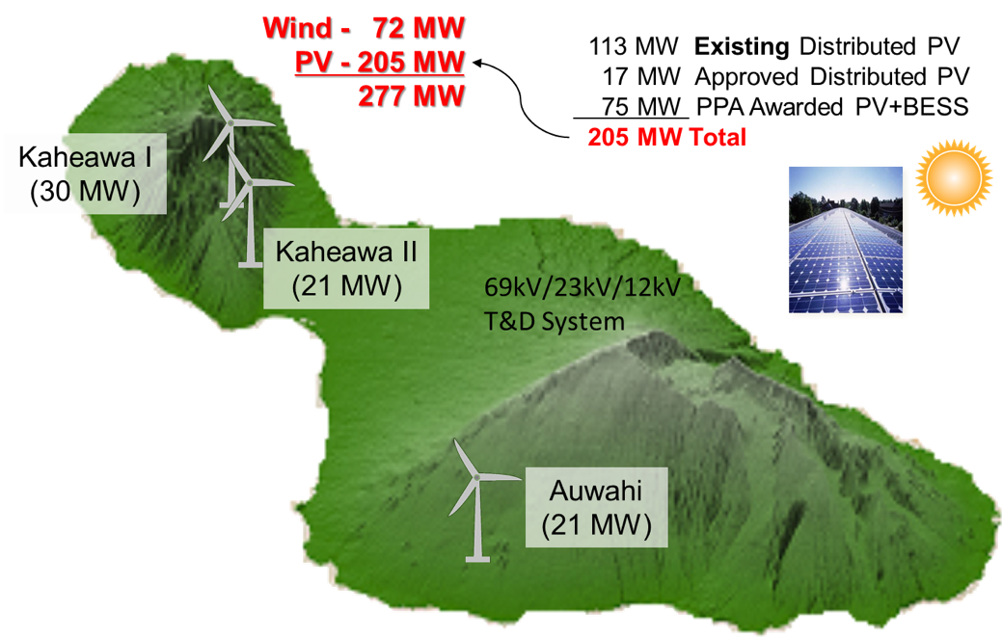
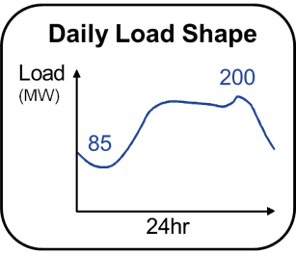
Maui Island
Leading the way in combined Solar and Wind integration
68,000 Customers
Installed PV & Wind @ 137% of System Peak Demand

Slide 12
Solutions to Increase Wind Energy Delivered on Maui
Facility | Percent of available energy delivered (% before / % after) | % increase in delivered energy
Plant 1 | 97% / 99% | 2%
Plant 2 | 72% / 84% | 17%
Plant 3 | 27% / 45% | 68%
BESS Function
10MW / 20MWh
Manual and AGC Dispatch
Aggressive frequency Response
Ramp Rate Limit within a limited SOC Range
MECO Operations
Include 10MW of BESS in Up Reserve
Reduce Down Reserve of M14 & M16 by 1.5MW
Reduced Operation of K1 and K2
50MW Up-Reserve Limit
Result: Reasonably priced bankable wind projects

Slide 13
O‘ahu Wind Integration Study (OWITS)
Focus on High Penetration Wind Scenarios
Scenario | Title | Wind |  |  | Solar PV
 |  | Oahu | Lanai | Molokai | Oahu
Baseline | 2014 Baseline | - | - | - | -
Scenario #1 | Oahu only | 100MW | - | - | 100MW
Scenario #2 | Oahu + Lanai only | 100MW | 400MW | - | 100MW
Scenario #3 | Oahu + Lanai + Molokai | 100MW | 200MW | 200MW | 100MW
+100MW new Wind
+100MW new PV
sub-sea cables
Molokai
+200MW new Wind
Lanai
+200MW new Wind
Three scenarios were analyzed to determine the unit commitment & dispatch, identify new operating characteristics, and establish a new baseline to assess mitigation strategies to enhance operation with high penetrations of renewables

Slide 14
Key OWITS Conclusions
O‘ahu can reliably accept 25% of its energy from 500 MW Wind (and 100 MW of PV) provided the following system modifications are considered:
Incorporate wind power forecasting
Refine operating reserve requirement (function of wind power forecast)
Incorporate other off-line resources for reserves (load control, fast-start generation)
Reduce minimum power of thermal units
Increase ramp rates and modify droop characteristics of thermal units
Apply advanced wind turbine capabilities (inertia, frequency response, curtailment)

Slide 15
Hawaii Electric Systems –
4 Electric Utilities; 6 Separate Grids; % Renewable Energy
Kauaʻi Island Utility Cooperative
System Peak: 78 MW
86 MW PV* / 7 MW Biomass / 9 MW Hydro
Installed PV: 110% of System Peak
Maui Electric
Maui System Peak: 202 MW
113 MW PV / 72 MW Wind
Installed PV & Wind:
91% of Sys. Peak
Lana’i System Peak: 5.1 MW
3.8 MW PV (75% of Sys. Peak)
Moloka’i System Peak: 5.6 MW
2.2 MW PV (41% of Sys. Peak)
*14 MW Solar under construction
Kaua’i
44%
Oʻahu
80% of state population
21%
Molokaʻi
Hawaiian Electric
System Peak: 1,206 MW
620 MW PV* / 99 MW Wind /
69 MW WTE / 168 MW Biofuel
Installed PV & Wind:
60% of System Peak
Maui
38%
Hawaii Electric Light
System Peak: 192 MW
101 MW PV / 31 MW Wind /
38 MW Geothermal* / 17 MW Hydro
Installed PV & Wind:
69% of System Peak
Lanaʻi
Hawaiʻi
44%
*77.5 MW of central PV and
24 MW of wind under construction
27.6 %
Renewable Energy Statewide
2018
*Geothermal Plant not in operation
21.5 MW Biomass under construction
Notes:
As of 9/2019
HELCO
101 MW DG
Wind
10.5 MW - HRD
20.5 MW - Pakini Nui
31 MW
RR Hydro
12.1 MW – Wailuku River
1.1 MW – Waiau
3.4 MW – Puueo
16.6 MW
Geothermal
38 MW – PGV
Biomass
21.5 - Honua Ola (Under Construction)
MECO (See Maui Island slide notes)
Solar
2.2 MW DG – Molokai
1.6 MW DG – Lanai
1.2 MW Central – Lanai
3.8 MW
111.54 MW DG – Maui
2.87 MW – Kula Solar
2.87 MW – SMRR
117.28 MW
Wind
30 MW – KWP
21 MW – Auwhi
21 MW – KWP 2
72 MW
HECO
Wind
30 MW - Kahuku Wind
69 MW - Kawailoa Wind
99 MW
Solar
448 MW - DG PV
1 MW - Kalaeloa Renewable Energy Park
5 MW - Kalaeloa Solar 2
5 MW - Kalaeloa Renewable Energy Park
5 MW - Waihonu North
1.5 MW - Waihonu South
27.6 MW - Waianae Solar
5 MW - Aloha Solar I
14.7 MW - Lanikuhana Solar
45.9 MW - Waipio PV (Waiwa PV)
49 MW – Kawailoa Solar
11 MW - Waipio Solar Facility
1.23 MW – Pearl City Peninsula PV
620 MW
110 MW – NRG (Under Construction)
20 MW – West Loch (Under Construction)
WTE
H-Power 68.5 MW
Biofules
110 MW - CIP
50 MW - Schofield
8 MW – Airport
168 MW
KIUC
Biomass
6.7 – Green Energy Biomass
Hydro
1.3 MW – Gay & Robinson
0.125 MW – Green Energy Hydro
1 MW – Kauai Coffee Kalaheo
4 MW – Kauai Coffee McBryde
0.800 MW – Waiahi (lower)
0.500 MW – Waiahi (upper)
0.500 MW – Waiawa
1.25 MW – Waimea
9.475 MW
25 MW – West Kauai Energy (Proposed)
Solar
20 MW – AES Lawai Solar (Under Construction)
21 MW - DGPV
1 MW - Kapaa Solar
12 MW –Anahola (REC solar)
12 MW – Koloa (SolarCity)
0.300 MW – Kaneshiro
6 MW – Port Allen
13 MW – SolarCity/Tesla
0.25 MW – pioneer
0.25 MW – Waimea Research
0.5 MW - Wilcox
86.3 MW
14 MW – AES Kekaha (In Construction)
Hawaii Renewable Energy Projects
Directory
https://energy.ehawaii.gov/epd/public/energy-projects-map.html

Slide 16
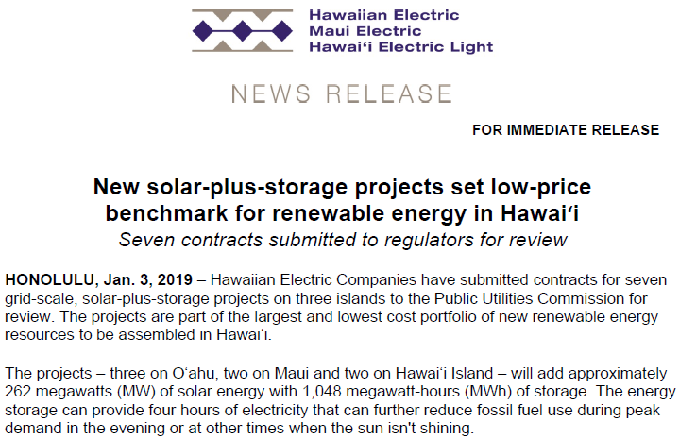
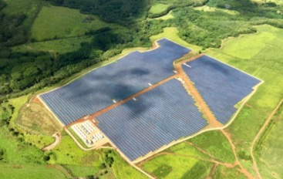
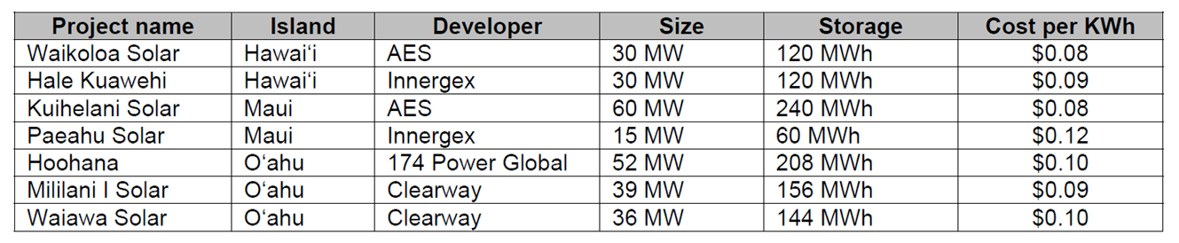
“Hawaiian Electric Announces ‘Mind-Blowing’ Solar-Plus- Storage Contracts”
“It’s hard to overstate the scale of this announcement,” said Dan Finn-Foley, a senior energy storage analyst at Wood Mackenzie Power & Renewables.
Source: Jan. 4, 2019, Greentech Media
HECO to install 1 GWh of new BESS
Entire BESS market in US today is 1.4 GWh
Source: Jan. 4, 2019, Greentech Media

Slide 17
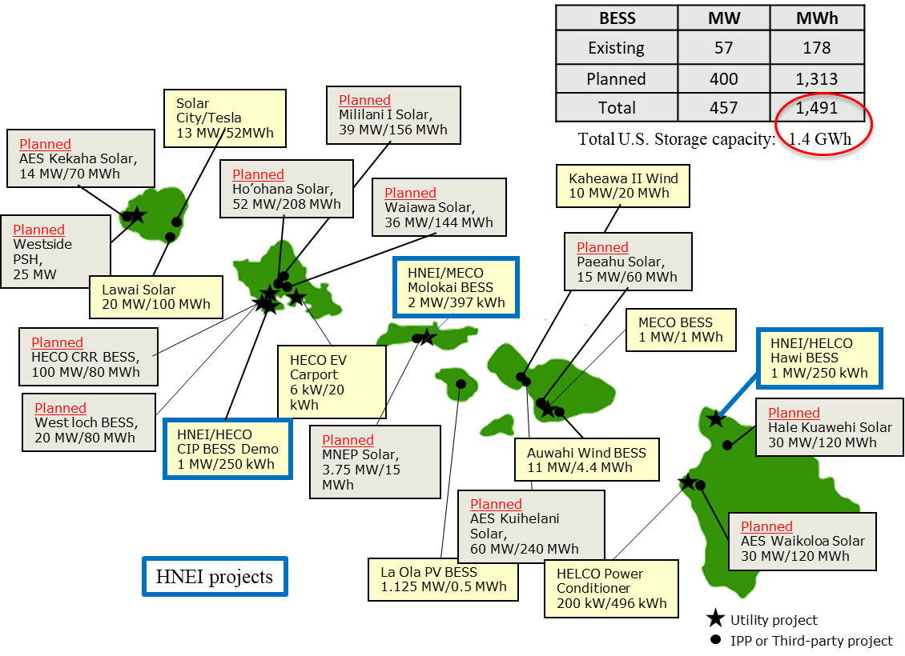
Hawaii BESS Projects

Slide 18
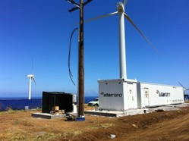
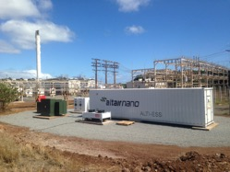
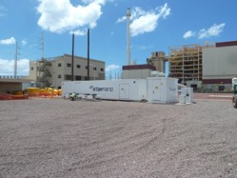
Grid Scale BESS Projects (HNEI)
Demonstrate optimized BESS operating strategies for high value grid applications
Upolu Point, Hawaii Island (1MW, 250kWh)
  Frequency regulation and wind smoothing
  3.3 GWh over 3yrs, > 6000 full cycles
Molokai Secure Renewable Microgrid (2MW)
  Fast dynamic response decision and control (<50ms response)
  Operating reserves (fault management), frequency management
Campbell Park industrial feeder with high penetration (1MW)
  Power smoothing, voltage and VAr support, and frequency regulation

Slide 19

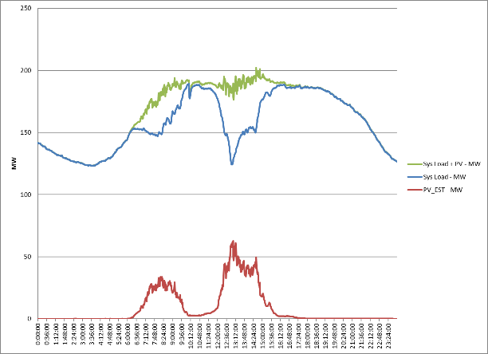
HNEI Solar Forecasting System
System provides solar resource and PV production estimates at a range of timescales from minutes to days ahead
Day ahead forecasts
  Regional numerical weather prediction model
  Regional forecasts - hours to days ahead
  Unit commitment planning
Hour ahead forecasts
  Satellite imagery
  Regional forecasts – 10 minutes to hours ahead
  Unit dispatch and operational reserve management
Minute ahead forecasts
  Ground-based cameras
  Local forecast - seconds to minutes ahead
  Grid stability and short ramp identification
Figure: Forecasting time and space scales of the different components that make up the solar forecasting system.

Slide 20
Hawaii’s Lessons from the Future
Effective and timely RE grid integration analysis and planning is foundational to manage RE development risk and reliable grid operation; identify grid challenges and solutions up front
Inverter technology has greatly advanced; all RE projects should contribute to grid operation and reliability within present technical capabilities
Grid codes are essential for long-term effective grid operations with high RE; update regularly
Transmission line development takes time; keep up with the need to avoid congestion and RE curtailment risk (risk increases cost of energy and threatens PPA investments and bankability)
Utilize RE competitive procurements now in place of feed-in-tariffs and bilateral PPA negotiations to secure RE; secure what you want, when you want it, and at the best price.
While growth in wind & solar RE development is rapid in many countries across Asia, total system RE penetration still remains relatively low by percentage of energy use through 2030 due to very rapid load growth
The need for battery energy storage systems (BESS) today in much of the ASEAN is not strong, aside from specific unique applications; don’t prematurely invest in BESS

Slide 21
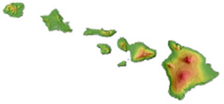

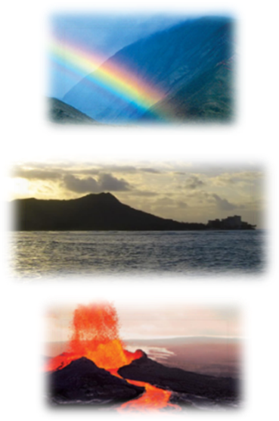

Mahalo!
(Thank you)
For more information, contact:
Leon R. Roose, Esq.
Principal & Chief Technologist
GridSTART
Hawaii Natural Energy Institute
School of Ocean & Earth Science & Technology
University of Hawaii at Manoa
1680 East-West Road, POST 109
Honolulu, Hawaii 96822
Office: (808) 956-2331
Mobile: (808) 554-9891
E-mail: lroose@hawaii.edu
Website: www.hnei.hawaii.edu
Grid System Technologies Advanced Research Team

Slide 22
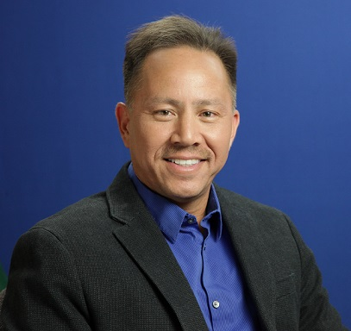
Grid System Technologies Advanced Research Team
Mr. Roose is a tenured faculty member of the Hawaii Natural Energy Institute (HNEI), University of Hawaii, where he formed and leads GridSTART, (Grid System Technologies Advanced Research Team), a research team focused on the integration and analysis of energy technologies and power systems, including smart grid and micro grid applications.
He served in numerous leadership roles at the Hawaiian Electric Company for 19 years prior including management of renewable energy planning and integration, generation resource planning and competitive procurement, negotiation of all power purchase agreements for the utility, transmission and distribution system planning, smart grid planning and projects, system relaying and protection, and fuel purchase and supply to utility generating plants. He is a licensed attorney, worked in private law practice in Hawaii and was formerly Associate General Counsel at Hawaiian Electric. He holds a B.S. in Electrical Engineering and a J.D. from the University of Hawaii.
Leon R. Roose
Chief Technologist

Slide 23
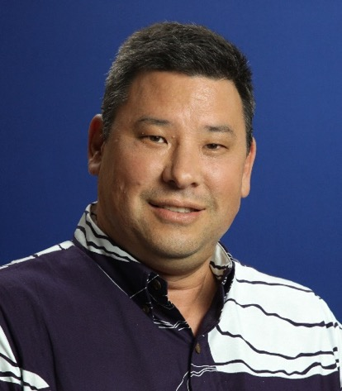
Grid System Technologies Advanced Research Team
Marc M. Matsuura
Sr. Smart Grid Program Manager
Marc joined the Hawaii Natural Energy Institute (HNEI), School of Ocean & Earth Science & Technology, University of Hawaii at Manoa, in 2013 as the Senior Smart Grid Program Manager and is a founding member of GridSTART (Grid System Technologies Advanced Research Team).
Prior to joining HNEI, he was with the Hawaiian Electric Company for 21 years. His career at Hawaiian Electric included positions in the areas of Transmission & Distribution (T&D) Engineering, T&D Standards and Technical Services, System Operations, Transmission Planning, Smart Grid Planning, and System Integration. Marc is a licensed professional electrical engineer in Hawaii. He holds a B.S. in Electrical Engineering and an M.B.A. from the University of Hawaii.

Slide 24
Hawaii Natural Energy Institute (HNEI)
University of Hawai‘i at Mānoa
Organized Research Unit in School of Ocean and Earth Science and Technology (SOEST)
Founded in 1974, established in Hawai‘i statute in 2007 (HRS 304A-1891)
Conduct RDT&E to accelerate and facilitate the use of resilient alternative energy technologies and reduce Hawaii’s dependence on fossil fuels.
Diverse staff includes engineers, scientists, lawyers; students and postdoctoral fellows; visiting scholars
Areas of Interest
  Policy and Innovation
  Grid Integration (GridSTART)
  Alternative Fuels
  Electrochemical Power Systems
  Renewable Power Generation
  Building Efficiency
  Transportation
Core Functions
State Energy Policy Support
Research & Development
Testing and Evaluation
Analysis
Workforce Development

Slide 25

Established to develop and test advanced grid architectures, new technologies and methods for effective integration of renewable energy resources, power system optimization and resilience, and enabling policies
Serves to integrate into the operating power grid other HNEI technology areas: energy efficiency, renewable power generation, biomass and biofuels, fuel cells and hydrogen
Strong and growing partnerships with Hawaii, national and international organizations including Asia-Pacific nations
Expertise & Focus:
Energy Policy
Renewable Energy Grid Integration
Smart Grid Planning & Technologies
Power Systems Planning
Power Systems Operation
Power Systems Engineering and Standards
Communications Design and Testing
Project Management and Execution
Lead for many public-private demonstration projects

Slide 26




























Core Team Members:
Richard Rocheleau Director, HNEI
Leon Roose * Specialist & Chief Technologist
Mark Glick * Specialist, Energy Policy
John Cole * Senior Policy Strategist
James Maskrey * Energy Efficiency Program Manager
Marc Matsuura * Senior Smart Grid Program Manager
Kanoa Jou * Power Systems Engineer
Staci Sadoyama * Power Systems Engineer
Thai Tran Junior Power System Engineer
Silas Oliviera de Toledo Junior Power System Engineer
Brian Chee Communications & IT System Analyst
Dax Mathews Renewable Energy Resources Forecasting
Kevin Davies Assistant Researcher
Saeed Sepasi Assistant Researcher
Jonathan Kobayashi Research Associate
Sharon Chan GIS Specialist
Yan Chen Post-Doctoral Fellow
Quynh Tran Post-Doctoral Fellow
Arif Rahman Post-Doctoral Fellow
Sampling of Sponsors & Partners:
Team members combine for 75+ years of utility and regulatory experience
* Prior electric utility company senior management and staff
* Prior Commissioner of the Hawaii State Public Utilities Commission
* Prior Administrator of the Hawaii State Energy Office

