Slide 1
Asia EDGE Regional
Competitive Procurement Dialogue
Evolution of Procurement in India’s Auctions- Solar
Bangkok, November 18-20, 2019
Anurag Mishra, Energy Team Leader, USAID/India
Notes:
Slide #1

Slide 2
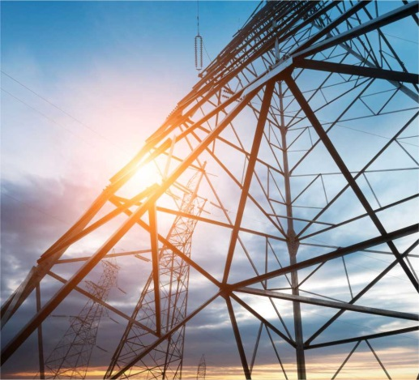
Bilateral Initiatives
Renewable Energy and RE Grid Integration
Buildings Energy Efficiency and Appliances
Distribution Utility Performance Enhancement
Energy Access
Air Pollution
Energy Modeling
Regional Programs (South Asia)
Regional Energy Security and Cross Border Electricity Trade
USAID/India Energy Programs

Slide 3
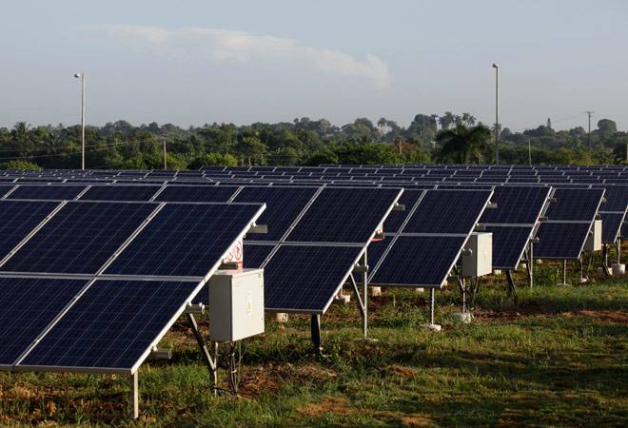
National Solar Mission
National Program: National Solar Mission (NSM) launched in 2010
Clear Target: Initial target of 20 GW by 2022 was revised to 100 GW
Phased Approach: Solar deployed in phases and batches. Phase 1 (2010 -13), phase 2 from (2013-17) and phase 3 (2017-22)
Competitive Procurement: Reverse Auctions, VGF, etc. at the National and State level

Slide 4
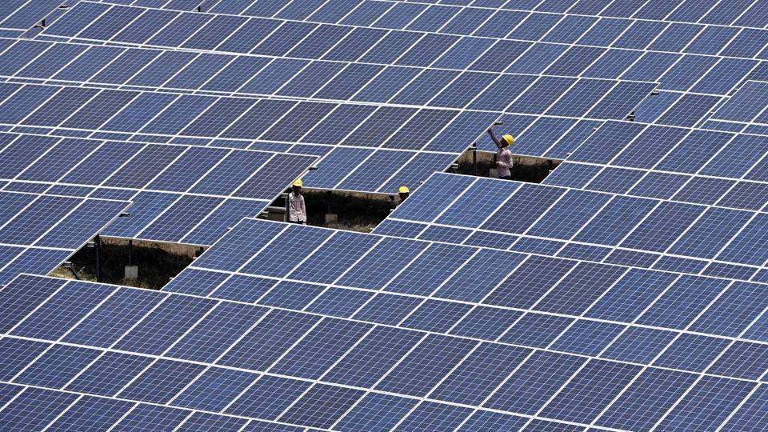
Solar Deployment in India
Installed Capacity
30 GW
Rooftop Solar Installed
2.2 GW
Target 2022
100 GW
Lowest tariff Rs 2.4/ kWh
(3.6 $ cents/ kWh)
38 Solar Parks, Largest Park 2,000 MW
New procurement trends – hybrid, floating solar, etc.

Slide 5
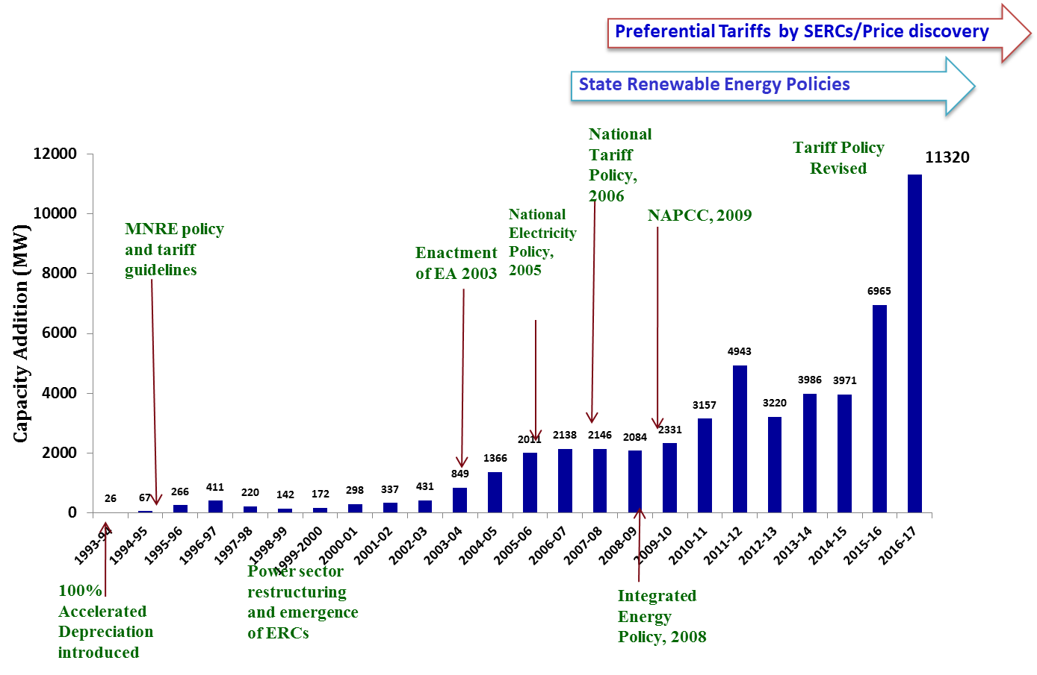
Supportive RE Policies and Regulations
National Solar Mission/ Auctions
First Wind Auction

Slide 6
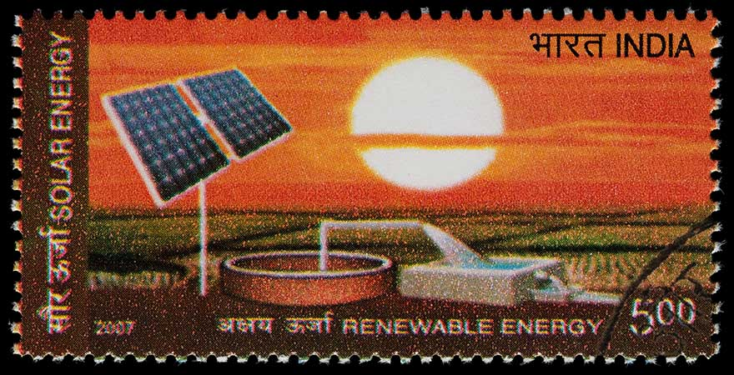
Trend -Solar Deployment and Tariffs in India
INR/kWh
MW

Slide 7
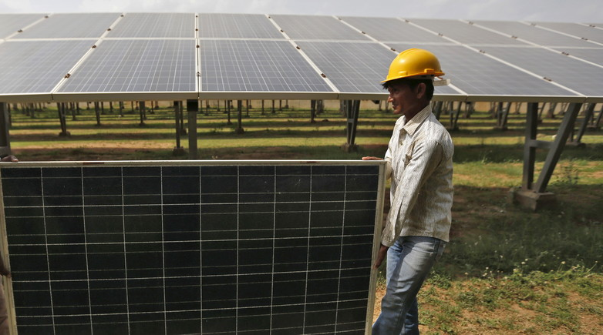
How India achieved this?
Rapid Adaptation of Auctions…
Source IRENA

Slide 8
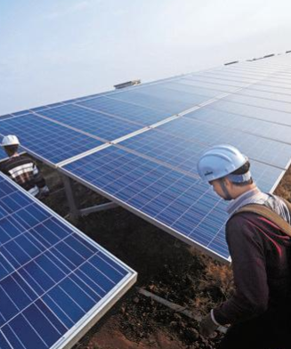
Auction Madhya Pradesh Solar Park
750 MW solar auction at state level
Featured lowest prices, but quickly beat out by subsequent auctions
IFC structured the auction and facilitated World Bank PRGs; helped state finance substation upgrades and transmission
Innovative PPA arrangement to take advantage of peak demand from 2 different offtakers
Real time bid adjustment through IT platform
Source: http://www.livemint.com/Industry/zW5Lf1okn054cFug5yKGsL/Madhya-Pradesh-solar-bids-hovering-at-Rs3-per-unit-in-revers.html

Slide 9
Auction Madhya Pradesh Solar Park
Source: IFC

Slide 10
Challenges faced by India
Lack of participation of local commercial banks
Delays in land acquisition
Limited field-level data availability on solar irradiation
Lack of power evacuation infrastructure
Need for local content
Multiple auctions at the same time with different conditions
Confusion over price discovery
L1 contract pricing (state level)
High currency risk and inflation risk

Slide 11
Key Learning
For new markets start with small capacities
Involve new players with balanced risk mitigation mechanisms
Keep objectives clear- RE capacity, Local Industry/Jobs, etc.
Transparent process boosts competition
Learn and adapt quickly

Slide 12
Key Learning
Manage the risk of bidder speculation
Involve project developers in early stage
Clearly understand the factors impacting the price
Bankable legal documentation help access low cost financing
Signal lender’s readiness to finance

Slide 13
Gird Integration of Large Scale Renewables
Established road map for achieving 175 GW of RE through grid integration studies
Undertaking four grid integration pilots
Regional reserve sharing: Creating National open access registry (for real time market) and benefits study (for modification of intra-day market)
Coal Flexibility: Damage modeling, Fleet Strategy, Regulatory framework
Battery Energy Storage System: Value of storage, potential for replication
Automatic Generation Control: AGC on hydro and RE, support nation wide deployment
Notes:
Forecasting and Scheduling
Deviation Settlement mechanism

Slide 14
Evolving System Friendly Procurement Approaches in India
Examples | Global Trend
SECI competitive procurement for hybrids | Physical hybrids
SECI competitive procurement for hybrids with assured peak supply | Time-based incentives & physical hybrids
SECI as demand aggregator | Virtual hybrid/aggregator
Bundling solar PV with thermal power | Virtual hybrid/aggregator
Banking power arrangements between DISCOMs | Virtual hybrid/aggregator
State-level & substation-specific competitive procurement | Locational signals
SECI site-specific competitive procurement | Locational signals

Slide 15
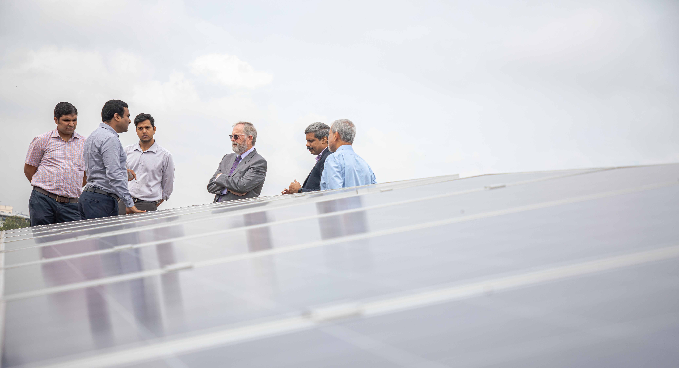
Thank You
Anurag Mishra
amishra@usaid.gov

