Slide 1
Design elements and country experiences I: general design, auction procedure, conditions for participation
July 16, 2019

Slide 2
Competitive procurement simulations
Interactive Session
Participants understand competitive procurement, its procedure and key considerations in competitive procurement design as follows:
Understand how competitive procurement works in practice and the strategic considerations in competitive procurement by playing the role of a bidder
Become familiar with the concepts of winner’s curse, how it is perceived by bidders, and which design features can help mitigate the risk of winner’s curse
Appreciate how the sunk costs involved in participating in competitive procurement affect bidding strategies, and how design of competitive procurement be done considering sunk costs

Slide 3
Simulation A – the winner‘s curse
Interactive Session
Competitive procurement for a renewable energy project
The bidder has difficulty in estimating his costs (symbolized by a can with cash). Each bidder estimates the amount of the cash in the can and notes it on a piece of paper. Cover the piece of paper.
Static sealed bid auction – all bidders hand in their bids at the same time
Each bidder decides on a bid price and writes it on a piece of paper.
Announcement and evaluation of the results
Based on Takon by Ehrhart, 2016

Slide 4
Introduction to the problem of the winner‘s curse
Definition
Auction bid price is less than the actual value of the good, which will result in a loss for the auction winner
Example
Excessive yield or underestimated costs
Impact on bidders
Often bidders tend to estimate the costs relatively well
If bidders are guided by their cost estimates in their bid strategy, the bidder who underestimates costs wins the auction
Adequate bidding behavior
Upward adjustment of the cost estimation in case of having a winning bid
Adjustment of the bid where possible
Based on Takon by Ehrhart, 2016

Slide 5
Simulation B – The problem of sunk costs – see seperate instructions sheet
Interactive Session
Competitive procurement for a renewable energy project.
Static sealed bid auction – all bidders hand in their bids at the same time (write it on the paper and hand it in).
Each bidder will receive his individual project costs on a piece of paper. Bidders’ project costs are different.
Individual project costs consist of: already incurred costs (before the auction) and the remaining costs, which only accrue to auction winners.
Please write your bid on a piece of paper.
Start of the auction
Based on Takon by Ehrhart, 2016

Slide 6
Introduction to the problem of sunk costs
Definition
Losses caused by sunk costs not only affect auction losers, but also the auction winner of an auction
Example
Costs associated to project pre-development up to obtaining a permit
Bidding behavior
Optimal bidding strategy is based only on residual costs and, if necessary, deducts sunk costs
Consequences due to sunk costs
Lower acceptance or non-participation by bidders
Risk of non-realization
Based on Takon by Ehrhart, 2016

Slide 7
Focus on auctions: overview of competitive procurement design
Target definition
Market & regulatory analysis
Procurement design
Imple-mentation
Evaluation
Policy goals
Market size
Pre-developed project
Market players
Technology cost
Project development & operation
Existing regulations & incentives
Institutional set-up
What is auctioned
Procurement procedure
Conditions for participation
Enforcement of obligation
Rights for awarded projects
Drafting of required documents
Market building
Procurement conduction
RfQ
RfP and awarding of bids
Contracting
Monitoring of realization
Lessons learned
Adjustment of procurement design

Slide 8
Overview of different design elements and functions
What is procured
Technology type, technology size, auctioned item (kWh, KW, budget), multi vs. single-item auction
Competitive procurement
procedure
Static vs. dynamic auctions, price, selection criteria, pricing rule, number of rounds
Conditions for participation
Timing of the auction, technical requirements, financial bid bonds
Enforcement of obligations
Deadlines and penalties
Rights & obligations of awarded projects
Provisions against off-taker, political and currency risk
Institutions
Auction regulation, design, implementation, contract off-taker

Slide 9
Site selection and preparation: benefits and challenges
Government-site auction
Bidder-site auction
Auctioneer
Auctioneer
Project site
Bidder 1
Procured volume (e.g. 100 MW)
Selected & pre-developed
Bidder 2
Bidder 2
15 MW
25
MW
Bidder 1
Bidder 3
30 MW
30 MW
Bidder 3
Bidder 4
Bidder 4
Benefits
Grid-compatible RE development.
Lower risks & costs of project development if adequate quality.
Challenges
Higher admin. burden on government.
Reduced role of bidders in finding optimal site.
Risk of ‚faulty‘ site selection and preparation.
Benefits
Lower admin. burden on government.
Site-specific risks mitigated through bidder-driven project development.
Challenges
Lower grid-compatible RE development in absence of locational signals.
Higher risks & costs of project development if uncertainty about project costs and timeline.

Slide 10
Site selection and preparation: country examples
Government-site auction
Bidder-site auction
Auctioneer
Auctioneer
Project site
Bidder 1
Procured volume (e.g. 100 MW)
Selected & pre-developed
Bidder 2
Bidder 2
15 MW
25
MW
Bidder 1
Bidder 3
30 MW
30 MW
Bidder 3
Bidder 4
Bidder 4
Country examples
Country examples
Senegal’s Scaling Solar
Dubai/Abu Dhabi (UAE)
Morocco
Denmark offshore wind
South Africa (with easier project development in Renewable Energy Development Zones - REDZ)
Mexico, Chile

Slide 11
Selecting permitting required before the auction is crucial
The inherent project risk is highest at the start of a project yet costs are still low.
If the auction takes place early in the project development process, i.e. before permits affecting the business case of a project (depending on the country: land lease, grid connection) are secured, there is a risk projects are delayed or cancelled.
Conducting sufficient site feasibility studies and procuring key permits before the auction allows bidders to better estimate costs and makes projects more bankable. Feasibility studies should ideally be certified by an external agency e.g. research energy institute in Brazil.
Project failure risk declines with late auction.
Planning
Approval process
Construction
Operation
Early auction:
RfQ stage
RfP stage
Late auction:
RfQ stage
RfP stage
Project realization

Slide 12
Conditions for participation: balance is the key
Planning
Approval process
Construction
Operation
Early auction:
RfQ stage
RfP stage
Late auction:
RfQ stage
RfP stage
Project realization
Bidder qualification: South Africa
Financial capacity: Financial statements, letter of support lender,
Technical capacity: independently reviewed forecast energy sales reports
Site requirements: proof of land acquisition (title deed/notarial lease/unconditional land option)
Conditions for participation
Technical: Selection of projects with sufficient progress in planning
Financial: Bidders with intention to realize
Technical: Sunk costs
All: Prohibitive barrier for (some) bidders

Slide 13
Grid connection permit (1/II)
Type of grid connection permit required before the auction | No permit: increases risk of project delay or failure if uncertainty on when or if permit will be granted. In offshore wind auctions in Netherlands and Germany, grid connection permit is provided by the government (technology limited to specific sites) Preliminary permit (i.e. grid connection quotation/study): document from grid operator with indicative cost and timeline. South Africa: bidders request Cost Estimation Letter before bid submission. Proof of site control (letter from landowner) and initiation of environmental impact assessment need to be attached

Slide 14
Environmental impact and social assessment: South Africa, Uganda
South Africa – environmental standards
Renewable Energy Development Zones introduced in 2016 (for Bid Window 5) Strategic environmental assessments (SEA) are performed prior to bidders’ site selection. RE projects and the associated grid infrastructure to be developed with a simplified environmental authorization. RE deployment under the auction is not exclusive to the zone
Uganda GET FiT - IFC standards
IFC Performance Standards on Environmental and Social Sustainibility were part of the pre-qualification requirements and bid evaluation Advantage: “gold standard” on social and economic impact assessments and mitigation schemes for infrastructure projects → requirement for funding IFC and other lenders. Disadvantage: considerable costs on developers → compliance viable for few projects given auction timeline

Slide 15
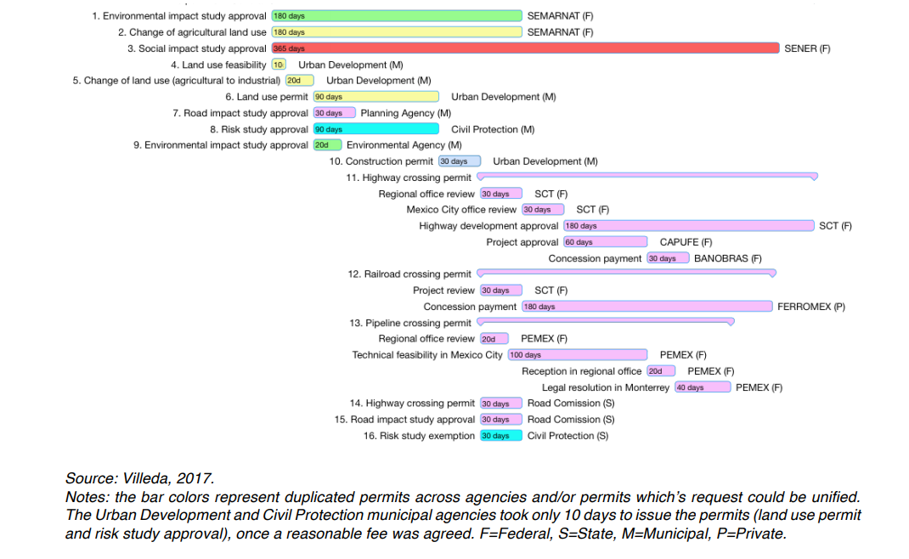
Be careful not to overburden bidders: In Mexico, EDF needed to interact with 13 agencies

