Slide 1
Auction Design – Part 1
November 18, 2019

Slide 2
Agenda
Definition and advantages of auctions
Policy goals and market & regulatory analysis
Auction Design Elements – Part 1
  Site selection
  Winner’s curse
  Pre-qualification requirements

Slide 3
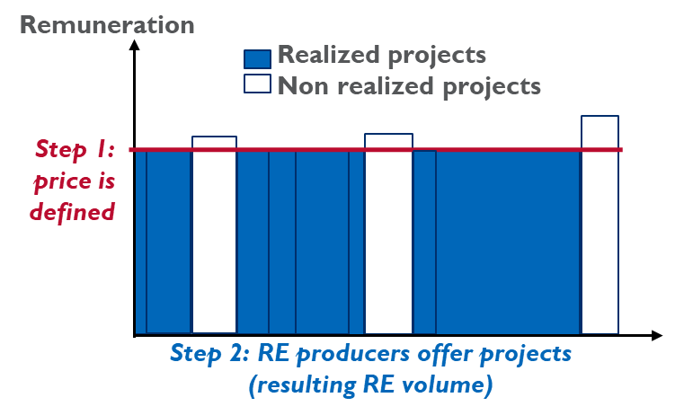
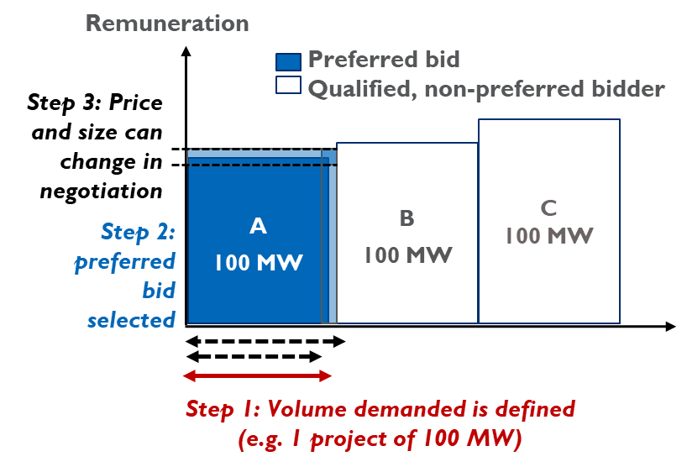
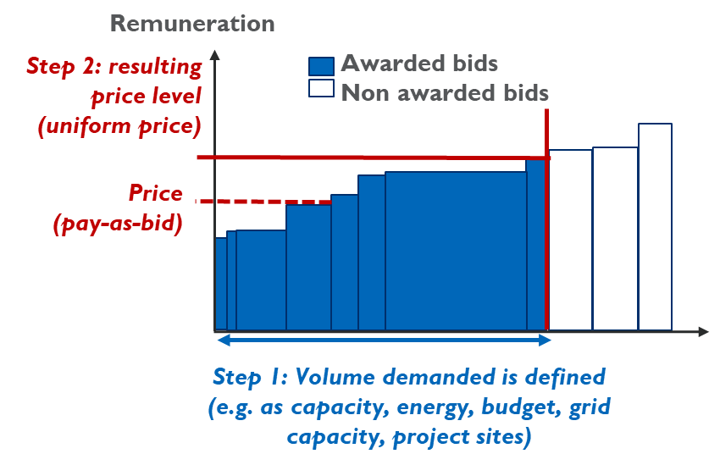
3 ways to determine RE tariffs: competitive procurement, negotiated procurement, administrative feed-in tariffs
Definition and advantages of auctions
All serve and require different levels of renewable energy market maturity
All result in different reflection of market knowledge
Market-based tariff setting
Admin. Feed-in tariff
Negotiated procurement
Competitive procurement

Slide 4
Admin. feed-in tariffs provide high certainty for producers, but little volume control and price competition
Definition and advantages of auctions
Advantages
Does not require intense competition.
Low risk for RE producers.
Disadvantages
Low volume control unless FIT has budget/capacity cap.
Slow in reacting to market price changes.

Slide 5
Negotiated procurement provides flexibility, but less scalable and transparent
Definition and advantages of auctions
Advantages
Volume control and flexibility to tailor project to need.
Some competition in pricing but lower than in auction.
Disadvantages
Risk of protracted negotiations → prices no longer reflective of market conditions.
Limited transparency in selection process.
Difficult to scale if many bidders present.

Slide 6
Competitive procurement provides strong volume control, price pressure and scalability, but needs competition
Definition and advantages of auctions
Advantages
Volume control.
Competitive pricing.
Faster project execution after award than in negotiated procurement.
Easier to scale up for multiple projects and rounds.
Disadvantages
Requires competition.
Bidders face risk of not being awarded (sunk costs).
Risk of underbidding and project failure.

Slide 7
… is competitive procurement always the best fit?
Definition and advantages of auctions
No.
Less mature technologies or small-scale generators with difficulties managing risk/transaction costs from participating in an auction.
Admin. feed-in tariff

Slide 8
… can competitive procurement be implemented in small RE markets?
Definition and advantages of auctions
Yes.
Formal participation and award criteria reduces the room for discretionary judgment calls in the process.
Challenges to process of negotiated procurement often cause delays
Competitive procurement

Slide 9
Defining targets and understanding the market & regulatory analysis are essential input for design
Definition and advantages of auctions
Target definition
Market & regulatory analysis
Procurement design
Imple-mentation
Evaluation
  Policy goals
  Market size
  Pre-developed project
  Market players
  Technology cost
  Project development & operation
  Existing regulations & incentives

Slide 10
RE targets and policy objectives need to be discussed and clarified early in the process
Policy goals and market & regulatory analysis
Target definition
Main goals:
  Allocating available funding efficiently and
  Achieving RE generation targets through timely project realization
Other policy goals include e.g.:
  Grid and system integration of awarded projects
  Local value creation
Recognize trade-offs between policy objectives and agree on prioritization, e.g.:
  Financial guarantees help ensure seriousness of bids and increase project realization, but could increase financing costs and lead to higher bid prices.

Slide 11
Competitive procurement needs to fit local market conditions to be successful
Policy goals and market & regulatory analysis
Market & regulatory analysis
Market size helps determine the expected level of competition in the competitive procurement and should inform the tendered volume.
Project development and operation phases inform e.g. types of permits required before the auction.
Ensure institutional capabilities meet auction requirements.
  Engage with key public stakeholders early on in the process, and select a point-of-contact.
  Consider the procuring agency’s capacity to transact, retain external expert advisors, especially at early stages

Slide 12
Focus on auctions: overview of competitive procurement design
Auction design elements – Part 1
Target definition
Market & regulatory analysis
Procurement design
Imple-mentation
Evaluation
  What is auctioned
  Procurement procedure
  Conditions for participation
  Enforcement of obligation
  Rights for awarded projects

Slide 13
Overview of different design elements and functions
Auction design elements – Part 1
General design
Technology type, auctioned item (kWh, KW, budget), site selection approach
Competitive procurement
procedure
Static vs. dynamic auctions, selection criteria, pricing rule
Conditions for participation
Timing of the auction, ceiling price, pre-qualification requirements, financial guarantees
Enforcement of obligations
Deadlines and penalties
Institutions
Auction regulation, design, implementation, contract off-taker

Slide 14
Site selection and preparation: benefits and challenges
Site selection
Benefits
Grid-compatible RE development.
Lower risks & costs of project development if adequate quality.
Challenges
Higher admin. burden on government.
Reduced role of bidders in finding optimal site.
Risk of ‚faulty‘ site selection and preparation.
Benefits
Lower admin. burden on government.
Site-specific risks mitigated through bidder-driven project development.
Challenges
Lower grid-compatible RE development in absence of locational signals.
Higher project risks if uncertainty about project costs and timeline.

Slide 15
Site selection and preparation: country examples
Site selection
Country examples
Country examples
Indonesia’s geothermal
Dubai/Abu Dhabi (UAE)
Malaysia, Thailand
Brazil, Mexico, Chile, Germany

Slide 16
Simulation – the winner‘s curse
Winner’s curse
Interactive Session
Competitive procurement for one (1) RE project.
The costs of the RE project ($/MWh) are given by the contents of the bag. Costs per piece:
  Dark chocolate → $4
  White chocolate → $2
  Milk chocolate → $3
Each bidder estimates the costs of the RE project and notes it on a piece of paper. Cover the piece of paper.
Each bidder decides on a bid price considering its cost estimate and expected competition, and writes it on a piece of paper. Cover the piece of paper.
Static sealed bid auction – all bidders hand in their bids at the same time.
Announcement and evaluation of results.
Based on Takon

Slide 17
Introduction to the problem of the winner‘s curse
Winner’s curse
Interactive Session
Definition
  Winning bids’ bid price is less than the actual value of the good, which will result in a loss for the auction winner
Example
  Excessive yield or underestimated costs
Impact on bidders
  Often a large group of bidders tend to estimate the costs relatively well
  If bidders are guided by their cost estimates in their bid strategy, the bidder who underestimates costs wins the auction
Adequate bidding behavior
  Upward adjustment of the cost estimation in case of having a winning bid
  Adjustment of the bid where possible
Based on Takon

Slide 18
Selecting permitting required before the auction is crucial
Pre-qualification requirements
Inherent project risk is highest at the start of a project
If the auction takes place early in the project development process, i.e. before permits affecting the business case of a project are secured, there is a risk projects are delayed or cancelled.
Feasibility studies and obtaining key permits before auction allows bidders to better estimate costs and makes projects more bankable. Feasibility studies should ideally be certified by an external agency
Project failure risk declines with late auction.

Slide 19
Conditions for participation: balance is the key
Pre-qualification requirements
Bidder qualification: South Africa
Financial capacity: Financial statements, letter of support lender,
Technical capacity: independently reviewed forecast energy sales reports
Site requirements: proof of land acquisition (title deed/notarial lease/unconditional land option)
Conditions for participation
  Technical: Selection of projects with sufficient progress in planning
  Financial: Bidders with intention to realize
  Technical: Sunk costs
  All: Prohibitive barrier for (some) bidders

Slide 20
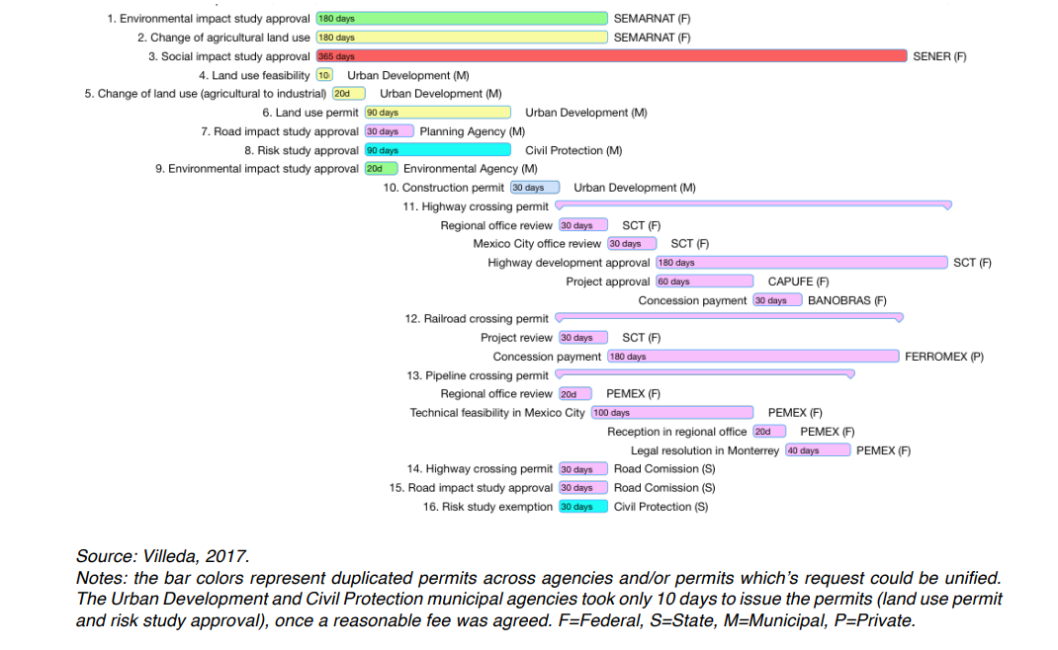
Be careful not to overburden bidders: In Mexico, EDF needed to interact with 13 agencies
Pre-qualification requirements

