Slide 1
Brazilian Power Auctions:
SWOT Analysis
Alexandre Viana – Thymos Energia, Brazil
November 18-20, 2019
Bangkok, Thailand

Slide 2
Agenda
Introduction of Brazilian market 03
Brazilian Power Auctions: Process and Design 11
Results 26
SWOT Analysis and Lessons Learned 33
Takeaways 40

Slide 3
Introduction to the Brazilian Power Market

Slide 4
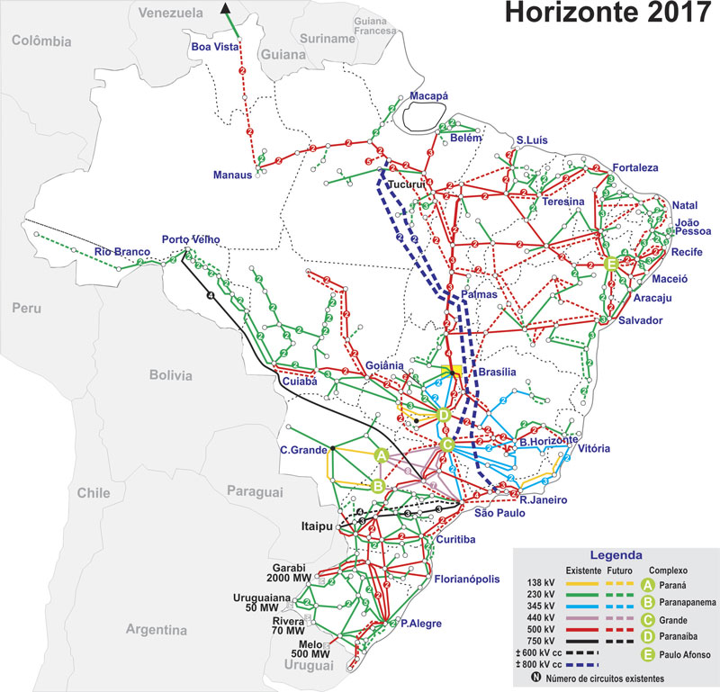
Brazil at a glance: 9th largest worldwide GDP and 10th largest consumption power market with a dynamic business environment.
COUNTRY FACT SHEET
Currency | Real (R$)
Exchange Rate (October 2019) | US$ 1 = R$ 4
Per Capita GDP (2017) | US$ 9,821
GDP (2017) | US$ 2,056 billion
GDP Growth Forecast (2018) | 1.36%
Inflation Rate (2017) | 3.5%
Economic Drivers | Agriculture, Steel and Mining, Services
Capital | Brasilia
Largest City | Sao Paulo
Population | 210 MM
Sovereign Credit Ratings | S&P BB-, Fitch BB, Moody’s Ba2
Area (surface) | 8.5 million km²
Source: IBGE, IPEA, Moody’s, Tendências, BACEN, ONS

Slide 5
Power Sector Governance tries to split State roles from political influence with the goal to provide better long-term management.
CNPE
National Council for Energy Policy
MME
Ministry of Mines and Energy
CMSE
Power Sector Surveillance Committee
ANEEL
National Regulatory Agency
EPE
Energy Research Company
ONS
National Grid Operator
CCEE
Market Operator
CNPE: Responsible for defining energy policies aimed at ensuring the country’s power supply.
MME: Responsible for the planning, management and development of sector legislation; supervises and controls the execution of energy policies.
EPE: Responsible for generation and transmission planning studies; subordinated to the MME, provides technical support to the energy auctions.
CMSE: Monitors the system to ensure reliability and guarantee of supply.
ANEEL: Regulates and monitors the generation, transmission, distribution and energy commercialization. Sets the tariffs and ensures financial and economic balance of the concessions.
ONS: Controls the operations of the National Integrated Grid to ensure optimization of the energy resources and supply reliability in real time.
CCEE: Manages the electricity market transactions and regulated auctions.
Market players (agents): Generators, Independent Power Producers (IPPs), Transmission Companies, Distributors, Traders and Free Consumers.
Source: Thymos Energia Research

Slide 6











Brazilian market design has two trading environments with different dynamics: Regulated Market (ACR) and Free Market (ACL).
Sellers
Generator, IPP and Trading Companies
Comments:
Discos are able to sell surpluses to ACL using a kind of auction called “Mecanismo de Venda de Excedentes” (MVE).
Migration to ACL requires a demand of 2.5 MW (2.0 MW from jan-2020 onwards).
Consumers between 0.5-2.5 MW can migrate to ACL. However, they are classified as Special Consumers and need to buy power from Small Renewables.
Free Consumers and Special Consumers can share portions of contracts.
There are different types of auctions.
ANEEL regulates different kinds of quotas from power plants, using a “cost-of-service” regulation.
Regulated Contracting Environment (ACR)
Free Contracting Environment (ACL)
Buyers: Discos
Buyers: Generator, IPP, Free Consumer, Special Conusmer and Trading Companies.
Contracting mechanism: Auctions or allocations undertaken by Aneel with specific regulations.
Contracting mechanism: Ove-the-Counter (OTC), private auctions or the Trading Platform (BBCE)
MVE
Source: Thymos Energia Research

Slide 7
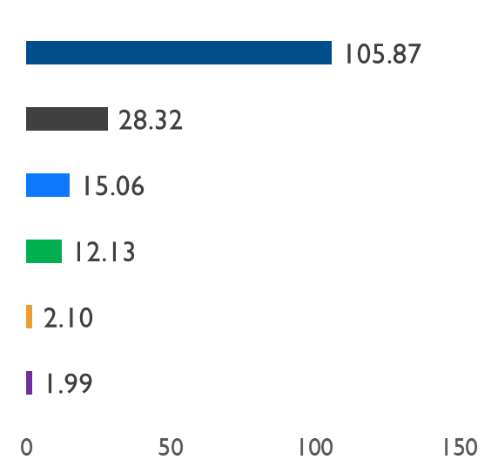

Total Installed Capacity is 165.5 GW with a pivotal share of hydro and small Renewables technologies.
Installed Capacity, Jun-2019
GW
Hydro
Fossil Fuel
135.17 GW or 81,68%
Wind
Comments:
Brazil has a long tradition in hydro.
Up to the end of 1990s hydro represented more then 90% of Installed Capacity.
Wind plants have gained market share over the last 10 years.
Solar PV is the new technology trend.
Biomass
Solar PV
Nuclear
Source: ANEEL – BIG (June-2019), Thymos Energia Research

Slide 8
Large hydro will keep its pivotal position in 2018-27 cycle, but wind and solar PV tend to keep increasing their shares.
Installed Capacity, 2018-27
MW per technology
Comments:
Large hydro will keep its pivotal position in Brazilian system, but new power plants are not planned in the PDE horizon.
Wind and Solar PV will keep increasing in the next 10 years.
Thermal power plants tend to remain quite stable in terms of Installed Capacity.
Open Cycle NG and storage technologies will be necessary to support new renewable additions in the system.
Source: EPE – Ten Year National Planning

Slide 9
Wind and solar PV tend to be the new additions in Brazilian system, relying on hydro and open-cycle NG.
Installed Capacity, 2018-27
% per technology
Comments:
Large hydro, small hydro and Itaipu will decline from 68% in 2018 to 58.7% in ’27.
Wind represents 8.4% in ’18 and will rise very robustly to 13.1% in ’27.
Solar PV tends to be the biggest winner in the 10-year horizon, increasing from 1.1% to 4.3%
Open-cycle NG and storage will be important to the the energy transition to small renewables.
Source: EPE – Ten Year National Planning

Slide 10
Consumption at 63.2 GWavg that has stagnated over the last 5 years due to economic crisis.
Consumption, 2009-23
GWavg
Comments:
Consumption presented robust growth between 2009-13.
Economic crisis stagnated consumption growth in 2014-17.
Consumption stagnation severely hit Discos position ending up in large surpluses of power contracts.
A slow economic recovery is observed in 2018.
Projections for 2019-23 are still surrounded by uncertainties due to slow economic recovery and the high growth of Distributed Generation.
Projection
Source: Thymos Energia Research, CCEE

Slide 11
Brazilian Power Auctions

Slide 12




Auctions are held in advance from the supply year: new power plants between A-6 to A-3 and existing plants from A-5 to A.
Supply Year
A
A-7
A-6
A-5
A-4
A-3
A-2
A-1
Types of Auction
New Energy Auctions or LENs: A-6 to A-3
Structuring Power Plants: A-7 to A-5
Contract Duration
PPA
Hydro, Small Hydro and Micro Hydro: 30 years
Existing Energy Auctions or LEEs: A-5 to A
Alternative Technologies Auctions or LFAs: A-6 to A-1
Wind, Solar PV and Biomass : 20 years
Fossil Fuel: 20 to 25 years, depending on the auction design
Reserve Energy Auctions or LERs: A-6 to A-1
Existing Energy Contracts have a duration between 1 to 15 years, and they do not distinguish the technology.
Brazilian regulation establishes a minimum of two auctions for new power plants every year (A-4 and A-6)
Source: Thymos Energia Research

Slide 13

Auction Process: Everything begins with key policy-drivers, then all other details are designed observing these goals.
Regulatory Aspects
Technical Aspects
Auction Operation
Results
Policy Drivers
Power Plant Construction
Contract Management
Policy makers must deeply analyze a country’s goals before designing auctions. Despite downward price trends, it is impossible to get all at once, especially Supply Adequacy and low tariffs, given the current market environment and prices.
Contract Management is very relevant and special attention should be paid over generation performance.
It is recommended a PMO (this role could be performed by a member from one of the involved stakeholders) to follow all steps and when auctions are permanent it is necessary a robust structure, as well.
Source: CCEE, Thymos Energia Research
DISCUSSION PURPOSES ONLY
13

Slide 14





How are auctions operated in Brazil?:
6 main steps to run auctions from scratch.
1
2
3
ANEEL coordinates all auction documentation (Auction rules, Contracts, Financial and Technical obligations).
MME publishes a Portaria - guidelines for the auction (date, technologies, variable costs cap).
MME certifies technical analysis and the FEC calculation undertaken by EPE.
Investors submit their projects to EPE, then it analyzes all projects and publishes technical certification (FEC - Firm Energy Certificates).
4
5
6
CCEE runs electronic auctions.
Winning-bidders sign contracts with Discos (Regulated auctions) or CCEE (Reserve Energy)
Market Players deposit bid bonds and formally register their participating in auctions at CCEE and ANEEL.
Winning-bidders with signed PPAs seek loans and/or funding to develop the projects.
Source: Thymos Energia Research
DISCUSSION PURPOSES ONLY
14

Slide 15
Bidding Mechanism: Is it relevant or just a confusing way to select players?
Renewables and fossil fuel
2007-2016
Renewables and fossil fuel
2017 onwards
Large Hydro
Two phases: Phase 1 is a sealed-bid, and Phase II (if necessary) is continuous trading.
Continuous trading is held only if there are other bids within 5% interval when compared to lowest bid.
In Phase II the lowest bid is the temporary winner and the other bidders can replace it offering a price lower than it, observing a minimum price reduction.
Auctions finish after 5 minutes without a valid bid.
Two phases: Phase 1 is a clock-auction and Phase II a pay-as-bid round.
Phase I: Auctioneer starts with a ceiling price and players inform the quantity they accept to sell at this price. After that, auctioneer reduces the price and players confirm or walk away of the auction. This process continues until a round where quantity is lower than demand + a margin.
When auction stops, auctioneer promotes all bids of the next-to-last-round and requests a final bid only of price.
There is a first round to submit quantity and price. At the end of the round the system organizes all bids from the lowest price up to the highest price. Bids that meet the demand are temporary winners and bids above the demand are temporary losers.
A second phase called “continuous” starts, and all temporary losers can submit new bids considering the marginal price minus a reduction. After each bid the clock restarts, with a typical countdown time of 3 minutes
Auction goes on until no valid bids are submitted within 3-minute interval.
Bid mechanism is relevant to get lower prices and to mitigate exploitation of market power.
Source: Thymos Energia Research
DISCUSSION PURPOSES ONLY
15

Slide 16
Winners sign contracts with Discos in a pool mechanism, observing the proportion of each Disco’s declaration.
Winners sign direct bilateral contracts with Discos, despite the centralized auction. Amounts are divided in several contracts by the proportion of Discos’ needs declared to MME. (Pool Contracting Scheme).
Attached to PPA there is a contract called Guarantee Contract (CCG). It allows the bank to block the current account of a Disco, working as an escrow account.
Disco 1
Disco 1
25%
25%
50%
Disco 2
Disco 2
50%
25%
25%
Disco 3
Disco 3
Source: CCEE, Thymos Energia Research

Slide 17



Environmental issues in Brazilian auctions: Why it’s easier to build a fossil fuel project than a large hydro?
Hydro power plants
When the river is inside the state, only a state agency license is required.
If the river crosses more than one state then a federal license from IBAMA is necessary. In some cases, even with IBAMA’s approval, approval from state agency is required as well.
The National Water Agency also needs to issue authorization regarding water usage.
Fossil fuel and renewables power plants
Only a state license is required, but some municipalities also require registration if the area of the power plant is considered sensitive for wildlife or strategic for the ecosystem.
  This classification is very subjective and brings discomfort for investors in some regions of the country.
Sometimes the discussion is not fully rational and very sensitive in public debate. Currently it is easier to get an environmental license for a fossil fuel power plant than a large hydro, especially because large dams are an easier target.
Source: Thymos Energia Research
DISCUSSION PURPOSES ONLY
17

Slide 18
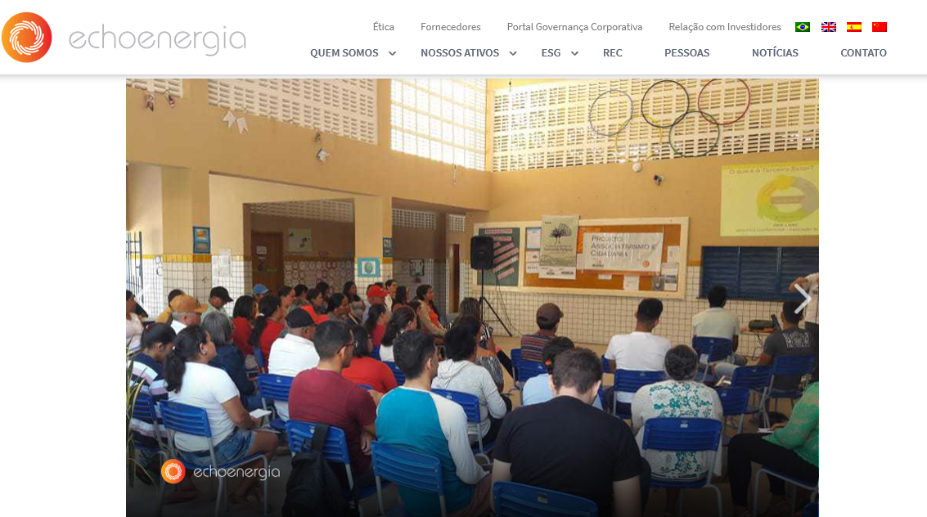

Investors do not have regulatory obligations regarding social matters, but the development of programs at local level is common.
Exemple 1 - Echoenergia
Exemple 1I – HPP Belo Monte
Echoenergia, a wind power generator where the major shareholder is the British fund Actis, has developed many programs to empower local communities with education for poor kids and training for unemployed adults.
HPP Belo Monte has several programs to help local communities such as:
Eradication of malaria in the region
Environmental conservation of rain forests
Business programs (cooperatives) to generate income for poor families.
Source: Thymos Energia Research
DISCUSSION PURPOSES ONLY
18

Slide 19

Local Content Requirements to develop industry and subsided loans helped pave the way to generate jobs.
A player that wants to get (subsided) loans from BNDES needs to fulfill rigid Local Content Requirement.
Normally 60% of equipment and 90% of the services need to be supplied by local companies.
This approach worked quite well for the wind industry, but solar PV is not following the same path especially due to strong competition from Chinese manufacturers that offset BNDES’ loans.
ANEEL estimates that awarded projects from power auctions generated 1.3 million jobs over the last 15 years.
Source: Thymos Energia Research, IRENA, BNDES, ANEEL
DISCUSSION PURPOSES ONLY
19

Slide 20


Current estimated values for CAPEX & OPEX in Brazilian market
Main Capex Drivers
Plant size.
TYPE | UNIT | MINIMUM | MAXIMUM
Wind
Capex | R$'k/MW | 3,600 | 4,000
O&M | R$'k/MW/year | 74.5 | 92.0
Photovoltaic
Capex | R$'k/MW | 3,100 | 3,800
O&M | R$'k/MW/year | 46.5 | 57.0
Hydro
Capex | R$'k/MW | 6,000 | 7,000
O&M | R$'k/MW/year | 77 | 96
Gas
Capex | R$'k/MW | 2,800 | 4,000
O&M | R$'k/MW/year | 67 | 100
Biomass
Capex | R$'k/MW | 2,400 | 8,000
O&M | R$'k/MW/year | 67 | 120
Main Capex Drivers
Plant size, dollar exchange and tracker usage.
Main Capex Drivers
Plant size, layout, reservoir and water height.
Main Capex Drivers
Plant size and turbine cycle.
Main Capex Drivers:
Plant size, turbine cycle and fuel (
sugarcane bagasse, wood)
Source: Thymos Energia Research
DISCUSSION PURPOSES ONLY
20

Slide 21



CCGs works as an escrow account, blocking the cash in the Discos’ account up to the amount necessary to pay the generator.
Generator issues the invoice to Disco and sends this information to the Management Bank
Disco sends the power bill to customers
Customers pay their bills in commercial banks
Management Bank makes the transfer from Current Account to the Consolidation Account up to the amount of the invoice. At settlement, the amount is transferred to the Generator’s account and the remaining funds of the Disco are allocated to the Current Account.
Brazilian Financial System makes the transfer from customers’ banks to the Management Bank
Source: CCEE, Thymos Energia Research

Slide 22
Fact Sheet of Brazilian Auctions (1/4)
Item | Description
Why auctions? | Auctions are competitive mechanisms that allow price discovery and can foster new technologies, especially if there is a legal and regulatory framework.
Buyers | Regulated Auctions: Discos that need to supply their loads. Reserve Energy: CCEE with the goal of improving Supply Adequacy.
Sellers | Independent Producers technically certified by EPE and with bid bonds deposited with CCEE.
Forward Period | New Energy Auctions: 3 to 7 years Existing Energy: 1 to 5 years Renewables tend to participate in 3-year forward auctions
Source: CCEE, Thymos Energia Research
DISCUSSION PURPOSES ONLY
22

Slide 23
Fact Sheet of Brazilian Auctions (2/4)
Item | Description
Delivery Period | Hydro: 30 years; Fossil fuels: 20 to 25 years, depending on the auction; Wind, Solar PV and Biomass: 20 years
Sellers Obligation | Winning bidders are contracted to build the power plant on time, deliver the electricity, and supply the contracted amount. Wind and Solar PV had special settlement terms to accommodate generation variability until 2016. Currently, Renewables are competing at closer conditions when compared to other technologies.
Sellers Financial Guarantees | Bid Bond: 1% of the investment to build the power plant Performance Bond: 5% of the investment
Source: CCEE, Thymos Energia Research
DISCUSSION PURPOSES ONLY
23

Slide 24
Fact Sheet of Brazilian Auctions (3/4)
Item | Description
Power Purchase Agreement (PPA) Guarantee | Regulated Auctions: There is a financial guarantee contract that allows the bank to make a direct transfer from Utilities’ bank account to generator’s account, avoiding Utilities discretionary management. Reserve Energy: CCEE has a fund equivalent to 1.5 times the total amount needed to pay all generators for a month; CCEE also uses the settlement of electricity produced to reduce the collection of surcharges from consumers.
Role of each entity | Auction characteristics: Ministry of Mines and Energy – MME Certification and Technical Studies: Energy Research Office – EPE Regulation: National Regulatory Agency – ANEEL Operation and Contract Management: Market Operator – CCEE Grid Access: National Grid Operator – ONS
Source: CCEE, Thymos Energia Research
DISCUSSION PURPOSES ONLY
24

Slide 25
Fact Sheet of Brazilian Auctions (4/4)
Item | Description
Environmental licenses | Licenses are obtained from the Federal Ministry of Environment when a river supplying a hydro facility crosses more than one state; Licenses are obtained from the applicable State Agencies for all other projects.
Time to Organize an auction | It generally takes 4 to 5 months to undertake an auction. However, the legal and regulatory framework took 2 years to be created (2003-2004), and the first auction took 7 months.
Source: CCEE, Thymos Energia Research
DISCUSSION PURPOSES ONLY
25

Slide 26
Results

Slide 27
All Brazilian auctions commercialized ≈ USD 472 billion or 9,571 TWh, representing one of the largest worldwide frameworks for power.
AUCTION TYPE | QTY | USD BILLION | ELECTRICITY (TWh)
New Energy | 29 | 300.74 | 5,508.153
Existing Energy | 20 | 65.19 | 1,617.394
Adjust Auction | 18 | 1.92 | 23.367
Reserve Energy | 11 | 42.17 | 722.932
Alternative Sources | 3 | 10.45 | 176.941
Structuring Projects | 3 | 52.00 | 1,522.811
Total | 84 | 472.47 | 9,571.598
Source: CCEE, Thymos Energia Research

Slide 28
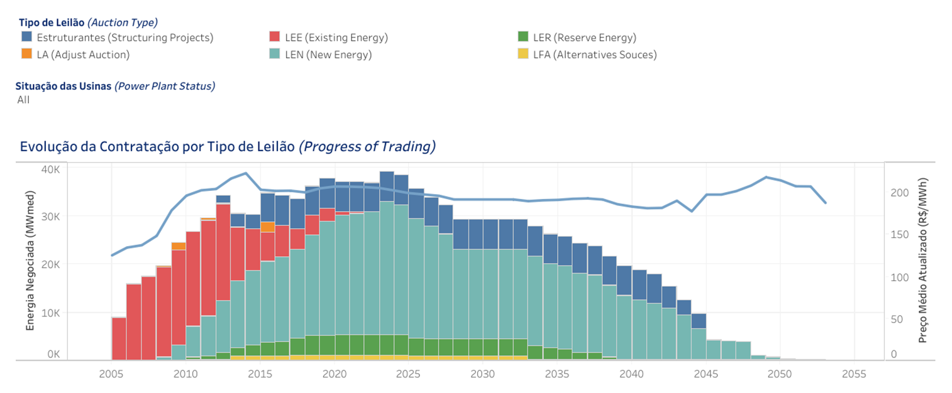
Portfolio indicates contracted energy until 2055, demonstrating a trade-off between security of supply and long-term rigidity.
Source: CCEE, Thymos Energia Research

Slide 29
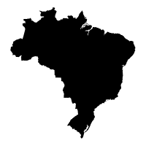





Supply Adequacy Auctions total 90,136 MW of new Capacity and Investments of ≈ USD 107 billion.
Capacity
90,136 MW
Investment
USD 107 billion
FECs
48,523 MW
Avg. Price
USD 57/MWh
Energy
39,070 MW
Avg. Discount
19.50%
Source: ANEEL, Thymos Energia Research

Slide 30
Hydro is the leader (29.8%) of contracted energy, followed by wind (19.3%) and Gas (18.7%). All bets for the increase of solar PV in the following years.
Supply Adequacy Auctions, contracted energy in MWavg, Dec-2005 to Sep-2019
% per technology
Comments:
A large number of thermal power plants were contracted between 2005-10.
Wind appeared as a competitive technology in 2009.
Solar PV begins as a serious player in 2014.
Hydro has the influence of large amounts from Structuring Power Plants.
LNG and Gas tend to be very relevant in the following years, especially due to Pre-Salt reserves on Brazilian coast.
Biomass has huge potential but there is no clear view how sugarcane market will evolve.
Results consider Reserve Energy Auctions.
Source: CCEE, Thymos Energia Research

Slide 31
New power plants: hydro has the lowest price (USD 41.63/MWh) and Diesel is the most expensive technology (USD 69.83/MWh).
Average Price of all Supply Adequacy Auctions, Dec-2005 to Sep-2019
USD per MWh
Comments:
Prices of all contracted power plants in all procurements held over the period.
Prices are CPI-indexed (IPCA from IBGE) as of September-2019 and converted into US dollar at exchange rate of BRL 4.00/USD 1.00.
Thermal plants consider ICB which is a scoring-bid used to classify the projects in the auctions.
Hydro prices are reduced because of HPP S. Antonio, HPP Jirau and HPP Belo Monte.
Solar PV presented high-prices in the first three auctions and the current trend points to low-prices, below R$ 130/MWh.
Source: CCEE, Thymos Energia Research

Slide 32
Price trends: technology evolution and regulatory issues are driving prices for renewables downwards.
Comments:
Downward trend is observed across the world due to technology evolution and lower interest rates.
In Brazil there are two additional points:
  Local currency (Reais) has faced devaluation over the last 5 years, coming from BRL 2.50/USD in 2014 to BRL 4.00/USD in Sep-2019.
  There is a phenomena called regulatory stamp. Projects that are awarded in auctions get licenses and connection more easily, so investors go to auctions and sell 30% of the project (minimum regulatory requirement) and try to get upsides in the free market later.
Auction prices for awarded renewable contracts, 2009-19
USD/MWh, exchange rate BRL 4.00/ USD 1.00
Source: CCEE, Thymos Energia Research

Slide 33
SWOT Analysis and Problems

Slide 34
SWOT Analysis: Supply Auctions and introduction of new technologies are relevant strengths; otherwise poor transmission signals is a weakness.
Strengths
Supply Adequacy
Introduction of new technologies, especially wind and solar PV
Market-based mechanism that foster competition and innovation
Bid-mechanism that allows price discovery
Weaknesses
Mechanism only for Regulated Market
Poor transmission signals
Lack of auctions for spot price formation
SWOT
Analysis
Opportunities
Implementation of auctions for spot price formation
Improvements on performance bonds
Better follow-up and monitoring of construction process.
Threats
Underbidding
Underbuilding
Funding highly dependent of subsided loans from National Development Bank (BNDES)
Source: Viana (2018), Thymos Energia Research
DISCUSSION PURPOSES ONLY
34

Slide 35
Grass is always greener: Brazilian auctions are good examples to address Supply Adequacy and Scale-Up Renewables, but they also have presented problems.
Four Real Problems:
Winner’s curse (2008)
Mismatch transmission and generation (2010-2013)
Gaming the system (2012-2016)
Underbuilding and De-contracting auction (2016)
Source: Viana (2018), Thymos Energia Research
DISCUSSION PURPOSES ONLY
35

Slide 36
1. Winner’s curse in 2008 (A-3 and A-5 auctions): Don’t bite off more than you can chew!
Context
A new company called MC2 Company is created to invest in power markets.
Main shareholders used to invest in protein business and had no experience in power business.
In 2008 they decided to heavily participate in auctions. After two procurements they were awarded with 2.7 GW of energy contracts. Contracts were backed up with new oil power plants.
Problem
MC2 was not able to develop the projects due a lack of funding and experience in power markets.
The situation ended up at ANEEL and MME. Both entities tried to find out a solution and gave extra time to build the power plants.
Even after extra time, most of the power plants were not built and Discos had to repurchase the energy in later auctions.
Solution for future auctions
Stricter rules regarding financial capability to build a large block of projects.
Severe penalties over directors and companies that call off contracts.
Source: Thymos Energia Research
DISCUSSION PURPOSES ONLY
36

Slide 37
2. Mismatch transmission and generation (2010-2013) ending up with a USD 1 billion cost: Better late than never!
Context
After the success of the first exclusive product for wind in 2009, Brazil decided to speed up new auctions between 2010-13.
Many projects were awarded in Northeast area regardless of grid connection.
Auctions for transmission lines were held later and the winners delayed the construction.
In the end power plants were built without grid connection.
Problem
In accordance with auction rules (and common sense) generators had the right to receive the contracts, despite lack of transmission.
Consumers had to pay the power twice, the contract for the newly built power plants and the actual consumed power.
The mismatch cost about USD 1 billion that was paid by Brazilian consumers.
Solution for future auctions
Auctions with closer delivery dates (A-3 or A-4) have a first phase called connection.
Power plants compete for grid access considering lowest bids for determined transmission points.
Lowest bids are promoted for the second phase and then the competition observes only projects that are able to inject power into the grid.
Source: Thymos Energia Research
DISCUSSION PURPOSES ONLY
37

Slide 38
3. Gaming the system (2012-2016): Cats and rats, robbers and cops!
Context
Brazil has a tradition of using electronic platforms for auctions due to the extent of the market and possibility of extracting more value from generators.
Bidding mechanism used between 2007-2016 was a hybrid clock round with a final pay-as-bid-round.
Bidders learned how to game the system and submitted one bid and then stopped bidding all together at the second round.
Problem
Auctions lost part of the meaning, because prices stop decreasing when compared to price caps.
Auctioneers stopped getting the actual price of technologies.
Policy-makers took time to accept the schemes existence, especially because it worked reasonably well for a long period (2007-12)
Solution for future auctions
A creation of a new bid-mechanism considering two phases. The first phase has only one round with a sealed-bid approach, just to organize the bids; second phase with a continuous trading approach with a countdown of 3min for a new valid bid and the system reorganizes all bids after a new one is received.
Excellent outputs, breaking the opportunity to game the system.
Source: Thymos Energia Research
DISCUSSION PURPOSES ONLY
38

Slide 39
4. Underbuilding and De-contracting auction: Once bitten twice shy!
Context
In Brazilian context, many players try to find ways of getting rid of their responsibilities using judicial system.
It has introduced a moral hazard into the system, and sometimes it affects players in the power sector.
Developers and poor-experienced companies enter in auctions to be awarded and resell projects later. In some cases they really think they are able to build them.
Problem
The delay rate is astonishingly high, around 30%. Non-completion rate is also relevant, hitting 10%.
Most projects are built (9 out of 10), but administrative and judicial disputes steal time of power sector stakeholders.
Solution for future auctions
One emblematic case was a de-contracting auction held in 2017 to avoid a long judicial battle. Winning-bidders were those that accepted to pay highest penalties. ANEEL cancelled 9 solar projects totaling 249.7MW of capacity and 16 wind farms with a combined capacity of 307.7MW.
De-contracting auction was held only once and is still considered a shame by Brazilian power sector.
New auctions have stricter rules and penalties, especially the enforcement of financial guarantees.
Source: Thymos Energia Research
DISCUSSION PURPOSES ONLY
39

Slide 40
Takeaways

Slide 41
Four Key Takeaways
1
Reverse power auctions are powerful tools to promote the Supply Adequacy and to scale up renewables, as well. Brazil is a good example to be analyzed due to its tradition with the mechanism.
2
Devil lives in the details: auctions must be carefully organized to assure transparency and fairness of the process.
3
Grass is always greener: Brazilian auctions are good examples to address Supply Adequacy and Scale-Up Renewables, but they also have presented problems (winner’s curse, mismatch transmission-generation, gaming the system, and underbuilding).
4
Avoid canned solution: Each country is unique; it is necessary to adopt a specific approach with the goal to increase the efficiency of the auction.
Source: Thymos Energia Research
DISCUSSION PURPOSES ONLY
41

Slide 42
Thank you!
Comments or questions
Please contact
Alexandre Viana
alexandre.viana@thymosenergia.com.br
+ 55 11 98177 0009

Slide 43

Alexandre Viana
Partner – Consulting Services for Energy Markets
Joined Thymos’ team in June-2019
20 years industry experience
Academics
Post-doctoral in Sciences with focus on Power Exchanges, Polytechnic University of São Paulo (USP), 2020.
PhD in Sciences with focus on Energy Markets and Auctions, Polytechnic University of São Paulo (USP), 2018.
MsC in Economics with focus on Macroeconomics, Catholic University of São Paulo (PUC-SP), 2007.
BsC in Economics, University Center of Santo André (FSA), 2002.
Relevant Experience
Thymos Energia since Jun-2019
Energy Market Research with focus on microeconomics, market design and power trading fundamentals.
Regulatory affairs of Brazilian power market such as concessions, auction rules, trading procedures. It also includes relationships with Brazilian stakeholders: market operator (CCEE), grid operator (ONS), energy office (EPE), agency (ANEEL) and ministry (MME).
Tariff analyses for regulated market (ACR) and effects over contracting dynamics, observing the expansion of free market (ACL).
Financial analysis for power sector with a focus on valuations for M&A and auction participation.
SPIC Pacific Hydro Feb-2018 to May-2019
Creation of a new trading area from scratch, including talent acquisition, software selection/analysis and procurement, development of trading governance procedures.
Management of trading operations: Back, Middle and Front Office, representing USD 400 million a year.
Supported decision-making process for CEO, CFO and M&A.
CCEE, Brazilian Market Operator Mar-2000 to Jan-2018
Led all phases of electricity auctions for Brazilian Regulated Market (Aug-2005 to Jan-2018), including business conception with policy makers (MME, ANEEL, EPE, ONS, CCEE), IT systems, administrative organization and represented CCEE to the press media. These auctions traded US$ 450 billion in contracts with different periods of maturity and delivery.

