Slide 1
Principles of bankable PPAs
Laura Kiwelu
Norton Rose Fulbright LLP

Slide 2
What is a power purchase agreement?
A PPA governs the sale and purchase of power between ProjectCo and the Offtaker.
It is the central document on an independent power project (IPP).
Sponsors, Lenders and the Offtaker have their own and shared objectives.
A PPA is a highly technical and financial document with a lengthy term. It is essential that it is fully understood and committed to by each party.
Any standardised or model PPA should be thoroughly considered and consulted on, and PPA negotiations should be constructive.

Slide 3
Renewable IPP structure
Lenders
Sponsors
Government
Shareholders
Agreement
Implementation
Agreement
ProjectCo
Offtaker
PPA
EPC Contract
O&M Agreement
Lease
EPC Contractor
Operator
Land Owner

Slide 4
What is ‘bankability’?
If a contract is ‘bankable’ it means that it is sufficiently robust to enable a project to reach financial close.
The PPA is crucial to bankability as it is the source of revenue for ProjectCo. If no revenues flow under the PPA then there are no funds to repay Funders and to pay operating expenses.
The concept of bankability is fluid and evolves as power markets evolve and new technologies become known.
As project finance is usually focused on a single SPV and a single Plant, the quality of the project documentation in supporting ProjectCo’s ability to repay debt and operate the Plant is crucial.

Slide 5
Why is project finance necessary?
Project finance is required by Sponsors to raise non-recourse or limited recourse debt.
The usage of project finance enables the transfer of technology risk to the private sector and takes the financing burden away from Government.
Establishing a robust framework for IPPs is a strong move towards a liberalised and self-supporting power sector.
“The availability of permanent financing (i.e. debt with a grace period equal to the construction period plus a repayment period of at least 10 years) on reasonable terms and conditions is a key pre-requisite to attract long-term investment from the private sector into the power sector in Sub-Saharan Africa”

Slide 6
Term and milestones
Financial Close
Commercial Operations Date
Development Period
(18 + months)
Construction Period
(@12 – 36 months)
Operating Period
(20 – 30 years)
Permitting / authorisations
Contracting (PPA, IA, EPC, O&M etc)
Financing
Studies
ESIA
CPs
Advisers
Land
Equity risk period
Construction completion risk
EPC contractor support
PPA performance bond
Testing and commissioning
Interconnection
Deemed completion
EPC & ProjectCo primary obligations
O&M obligations
Offtaker credit support effective
Reserve accounts
ProjectCo, O&M and Offtaker primary obligations

Slide 7
Construction and commissioning
ProjectCo will construct the Plant in accordance with laws, permits and good industry practice.
ProjectCo will provide and maintain the Performance Bond.
The Offtaker must have sufficient notice of synchronisation and commissioning for scheduling reasons. Monthly construction reports.
Pass through to EPC contractor.
The role of the Independent Engineer is essential as the Independent Engineer will certify COD by issuance of a certificate to both parties.

Slide 8
Commercial Operations Date
Anticipated COD
Required COD
Longstop COD
Programmed COD from time to time (floating). Base date for deemed completion?
Fixed ‘x’ months from Effective Date.
Triggers Delay liquidated damages (LDs)
Fixed ‘x’ months from Required COD.
Triggers default and termination
Delay LDs: payable by ProjectCo for each day of delay. Must be based on the Offtaker’s wasted costs and losses. Capped.
Capacity shortfall LDs: payable by ProjectCo for failing to achieve contracted capacity. Based on Offtaker’s loss. Capped.

Slide 9
Interconnection
The structure of interconnection arrangements must be clear from an early stage as this structuring will impact the tariff and may cause delay – Offtaker to construct? ProjectCo to construct? Both?
Offtaker must accept the commissioning energy and take necessary steps to enable interconnection and commissioning to take place.
Failure of Offtaker = deemed completion.

Slide 10
Sale and purchase of power
What power is being sold? Contracted capacity?
Sale of capacity or metered output only?
Where is the delivery point?
Is it exclusive?
What about commissioning energy?

Slide 11
Tariff
The tariff must be clearly and unequivocally stated
For non-dispatchable renewables the tariff will be energy charge only and will be stated simply as ‘x per kWh’.
If the tariff is subject to indexation or escalation this must also be clear.

Slide 12
Metering and invoicing
The metering provisions in the PPA are essential to ensure a smooth invoicing and payment process, as invoices are derived from the meter system.
The PPA must be clear as to: (i) who installs and commissions each meter, (ii) who owns and operates each meter, (iii) which is the main meter and which is the back-up meter, (iv) regular testing, (v) how to deal with inaccuracies, and (vi) how meters are read.
ProjectCo issues invoices.
Offtaker must either pay invoices within a specified time (usually 30 days) or dispute them on a fast-track basis.
No deductions and gross up.
Late payment default interest.
Ability to draw on credit support.
Discounts for prompt payment?

Slide 13
Liquidity support
A limited amount of cash which is ‘on demand’ to ProjectCo (letter of credit, bank guarantee or escrow).
A typical feature of most power trading transactions.
Requirements are driven by lenders.
Generally equivalent to 3-12 months of PPA revenues BUT this evolves and depends on the jurisdiction.
Putting in place liquidity support often causes delay.
Multilateral institution options are available - e.g. World Bank Partial Risk Guarantee, African Trade Insurance Agency (ATI) Regional Liquidity Support Facility.

Slide 14
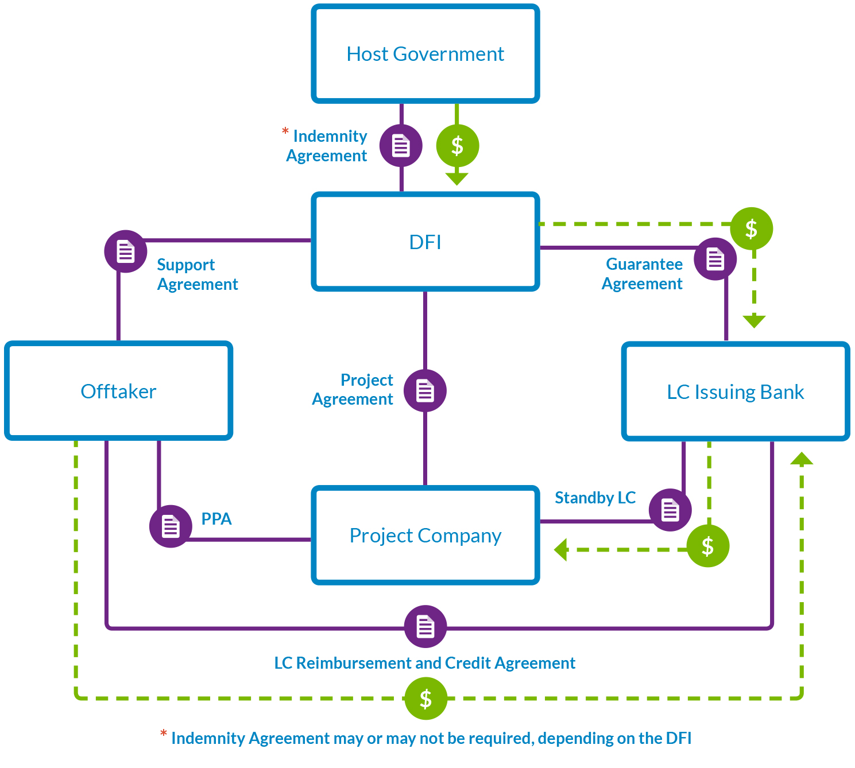
Liquidity support counter-indemnity structure

Slide 15

Currency and foreign exchange
HCY
ProjectCo
?
Offtaker
LCY
There is currently a mis-match on regional IPPs between the Offtaker’s revenues (which are in local currency LCY) and the opex and debt of ProjectCo (which are in hard currency HCY). Exceptions are South Africa and Namibia… and imminently Kenya.
This mis-match must be carefully addressed.
Undue exposure of ProjectCo to forex will increase the tariff.
It is generally acceptable for the tariff to be denominated in HCY but paid in LCY so as to avoid the Offtaker incurring the additional cost of converting its LCY revenues.

Slide 16
Convertibility protections
On each monthly payment date, ProjectCo will have revenues in LCY. ProjectCo must immediately convert to HCY for opex and debt service.
In order to limit ProjectCo’s monthly forex exposure, it is crucial that the conversion by the Offtaker of the energy payment to LCY takes place on the date of payment.
This structure is bankable, however residual Lender concerns: (1) LCY may not be freely convertible to HCY at some point during the term, and (2) the Government may not have enough HCY reserves.
The Offtaker / Government must therefore provide convertibility support by way of an indemnity in respect of shortfalls due to a short-term inability to convert and an obligation to make HCY available if there is a scarcity.
The Government must also ensure that ProjectCo can repatriate revenues.
Catastrophic inability to convert or repatriate? – PRI cover is available…. but at a cost.

Slide 17
Deemed energy
The Offtaker must accept and pay for the energy which is delivered to the delivery point.
Where the tariff is energy charge, ProjectCo would receive no revenue if there is a prolonged curtailment.
Deemed energy covers this risk – deemed energy is the energy that the Plant is deemed to have generated during a curtailment event.
There are various methods for calculating deemed energy, but the method chosen must be simple and fair.
What risk can ProjectCo accept – availability of contingent risk insurance to cover loss of revenue from events affecting the grid?

Slide 18
Means of limiting deemed energy
Bankable
Annual threshold of hours of allowed grid outage (usually around 100 hours).
Bankable?
Discounted deemed energy tariff?
Different treatment if grid issue is caused by force majeure?
Unbankable
Excluding a number of hours per curtailment event (as this means ProjectCo would not be protected upon repetitive curtailments of short duration).
An annual cap on deemed energy when aggregated with actual production (usually set at P50) to ensure that the developer is not over-compensated during a contract year of good generation followed by a curtailment.
Term extension?
Deducting deemed commissioning amounts at the end of the term?
No entitlement to deemed energy during commissioning or during the first year of operations.
Excluding where deemed energy is caused by a political event.

Slide 19
Risk allocation
It is a core principle of project finance that each risk should be allocated to the party that is best able to manage that risk.

Slide 20
Risk allocation – PPA / IA
The PPA may not allocate each risk, and generally any risk that should reside with either the Offtaker or the Government which is not allocated in the PPA would be expected to be allocated in the IA.
It generally varies whether the risks of change in law, change in tax or political events are allocated to the Offtaker in the PPA or to the Government in the IA.
The less risk the Offtaker is able to accept, the more risk will be allocated to the Government, and therefore IA negotiations would be prolonged.

Slide 21
Consequences of force majeure
Provided that the affected party complies with the notice requirements in the PPA, it should be relieved from its obligations and milestones should be extended for the period it is affected by the force majeure.
Force majeure affecting a contractor should entitle ProjectCo to relief under the PPA.
Economic hardship is not a force majeure and payment obligations are not excused by the occurrence of a force majeure.
Similarly, breakdown of plant and equipment or general contractor delay is not a force majeure.
Prolonged force majeure (i.e. 6-12 months) is a termination event.

Slide 22
Change in Law
Change in Law is an introduction of a new law / modification of an existing law / changes in interpretation of a law / lapse of a permit after the signature date which:
  adversely affects ProjectCo’s performance / renders performance impossible;
  adversely affects ProjectCo’s revenue stream;
  requires ProjectCo to incur one-off capex / ongoing opex increase; or
  conversely reduces ProjectCo’s capex or opex.
  Change in Law may have a positive or negative effect on a project’s economics. ProjectCo should be in no better or worse position due to a Change in Law.
  Materiality thresholds? Change in Law affecting Funders?
  Change in Law is a Political Event (time relief) but also a standalone event (revenue and costs relief).
  ProjectCo should be entitled to either direct compensation or an increase in the tariff, or a reduction of the tariff.

Slide 23
Performance
During the operating period each party must operate and maintain its assets in accordance with law, permits and good industry practice.
The regime for performance testing depends on the project specifics and the Offtaker’s requirements for that project.
Generally no output guarantees for renewables – instead availability or performance ratio testing.
Testing against forecast? Accuracy of forecasting is improving (e.g. Kenya).
Capped LDs for failure to meet required thresholds; ProjectCo event of default if unremedied prolonged failure. Force majeure, political events and Offtaker or Government breach must be excluded from testing.

Slide 24
Taxes and incentives – the fiscal regime
An uncertain fiscal regime causes delay to signing PPAs and setting the tariff. Which reliefs and exemptions apply to the Project?
Best practice is to set out the applicable tax regime as a schedule to the PPA – this sets a clear ‘day one’ position and movement from this is a Change in Tax.
Communication between the tax authority, the investment centre, the Offtaker, the central bank and Government is crucial.

Slide 25
Events of default
Seller Events of Default
Abandonment
Change in control?
Buyer Events of Default
Failure to pay
Failure to provide credit support
Mutual Events of Default
Insolvency
Assignment
Failure to start construction?
Failure to achieve COD
Prolonged failure to perform
Government breach?
Catastrophic change in law?
Sector restructuring?
Expropriation?
Misrepresentation
Material breach

Slide 26
Dispute resolution and governing law
Expert Determination
Escalation
Arbitration
International arbitration (ICC, LCIA, UNCITRAL) with a foreign seat is essential, however the arbitration may be located in close physical proximity (e.g. Johannesburg or Mauritius).
Local governing law of the PPA and IA is generally acceptable.
There must be a waiver of sovereign immunity by the Offtaker.

Slide 27
Example - Egypt
Onshore seat of arbitration was the rationale for the international financial community not to support Round 1 of the Feed-in Tariff Programme (2015/16). All precedent transactions in Egypt had employed a London seat of arbitration. The tariff for Round 1 was $c13.34/kWh
Egyptian Electricity Transmission Company wanted to use the Rules of the Cairo Regional Centre for International Commercial Arbitration (CRCICA) to settle disputes under the project agreements
Seat of arbitration and location of any physical hearings was to be Cairo, to reduce dispute resolution costs for EETC
Challenge risk
Egyptian law does not permit re-examination of merits
Annulment available for lack of jurisdiction (i.e. no arbitration agreement) or procedural impropriety, or contrary to previous Egyptian court decision or contrary to public policy
Conditions for annulment are similar to other jurisdictions
E.g. no / invalid arbitration agreement; failure to follow procedures; right to a fair hearing
Public policy is a general caveat
Appeal on point of law is common grounds for challenge
Final solution
In Round 2 the seat of arbitration was Paris, France.
The tariff for Round 2 was $c8.4/kWh
Bias
Concern that courts could intervene and exercise jurisdiction in a biased manner
Making an award that prefers EETC to the project company
Egyptian courts have historically demonstrated independence from the State
E.g. Court decision to nullify a maritime border treaty with Saudi Arabia
Recognised by academics as generally respecting the rule of law
Other factors
Precedent for use of Paris seat of arbitration
Fee caps for arbitrators disincentives properly qualified arbitrators
Difference between CRCICA Rules and other institutional rules (no time limit for award; no expedited procedure; no consolidation)
Production sharing contracts have all used Cairo seat and CRCICA Rules
2010 rules relaxed fees to attract higher calibre arbitrators for large disputes
Rules are based on UNCITRAL – not viewed as materially deficient

Slide 28
Direct agreements
The primary purpose of a direct agreement is for the Lenders to step-in to ProjectCo’s shoes following a ProjectCo default under either the PPA or the finance documents. The Lenders’ and the Offtaker’s interests are therefore aligned.
Direct agreements may also be used by Lenders as a tool to amend the PPA (where the Lenders were mandated after the PPA was signed). In this situation the direct agreement operates as a form of amendment agreement.
The PPA must include an ability for ProjectCo to assign its rights by way of security / charge its interest in the PPA to the Lenders.
Lenders
Offtaker
ProjectCo

Slide 29
PPA approval and execution
Who needs to approve the PPA before execution?
Role of the Regulator?
Corporate authorities and legal opinions

Slide 30
Any Questions?

